Slide 1
/Advanced Programming Project
Advanced Programming Project
Done By:
Ameera Attiah S21107316
Leen Sharab S21107195
Sara Alshumayri S20106125
Esraa Basalamah S21107013

Slide 2
/TABLE OF CONTENTS
/01
/INTRODUCTION
/02
/PROBLEM STATEMENT & DESIGN
/03
/TEST DRIVER
/04
/CONTROL CLASS
/05
/VIEW CLASS
Table of Contents
TestDriver.cc
Control.cc
Control.h
View.cc
View.h

Slide 3
/TABLE OF CONTENTS
/CLUB MEMBER CLASS
/06
/BOOK CLASS
/07
/08
/BOOK ARRAY CLASS
/09
/CLUB MEMBER ARRAY CLASS
/10
/RATING CLASS
Table of Contents
Book.cc
Book.h
Control.cc
Control.h
BkArray.cc
BkArray.h
CmArray.cc
CmArray.h
Rating.cc
Rating.h

Slide 4
/TABLE OF CONTENTS
/ MAKEFILE
/11
/BOOK CLUB CLASS
/12
/13
/EXECUTION OF THE CODE
/14
/TEAMWORK & PROJECT MANAGEMENT
/15
/CONCLUSION & REFLECTION
Table of Contents
Book.cc
Book.h

Slide 5
/01
/INTRODUCTION
Introduction
For this project, we were asked to write a C++ program to manage the data for a Book Club with books and members. We must implement our program using objects from different classes, based on a UML class diagram that was provided for us.

Slide 6
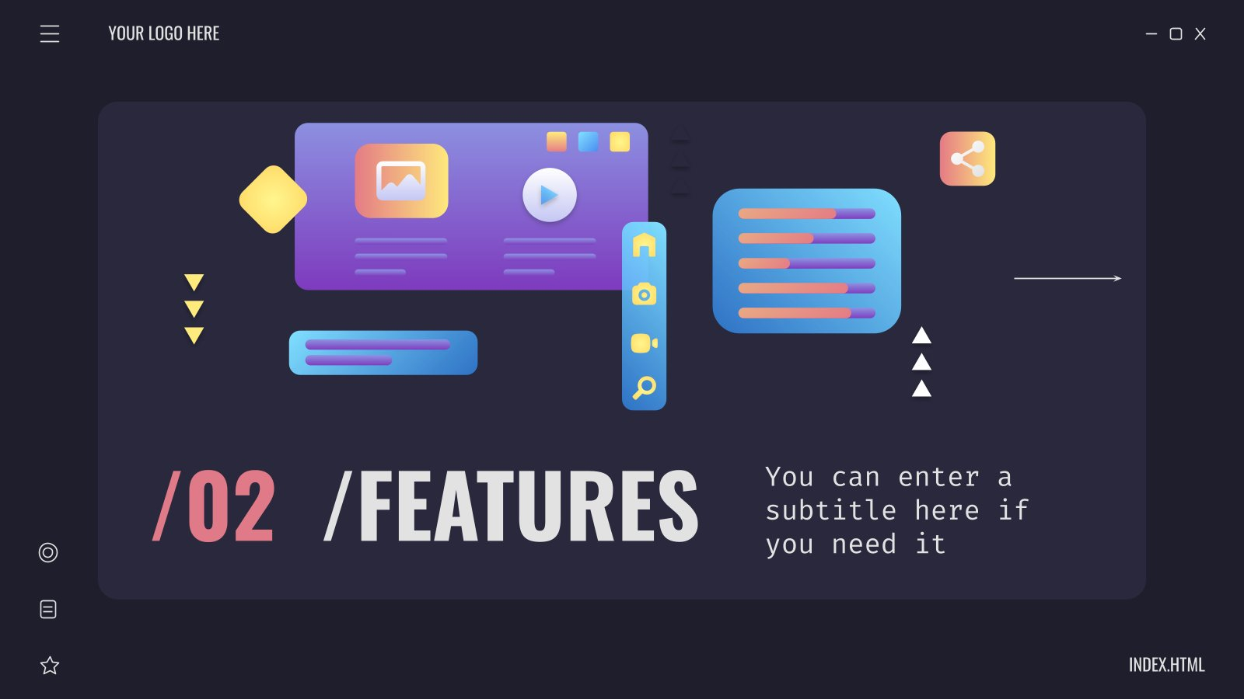




/02
/PROBLEM STATEMENT & DESIGN
Problem Statement & Design

Slide 7
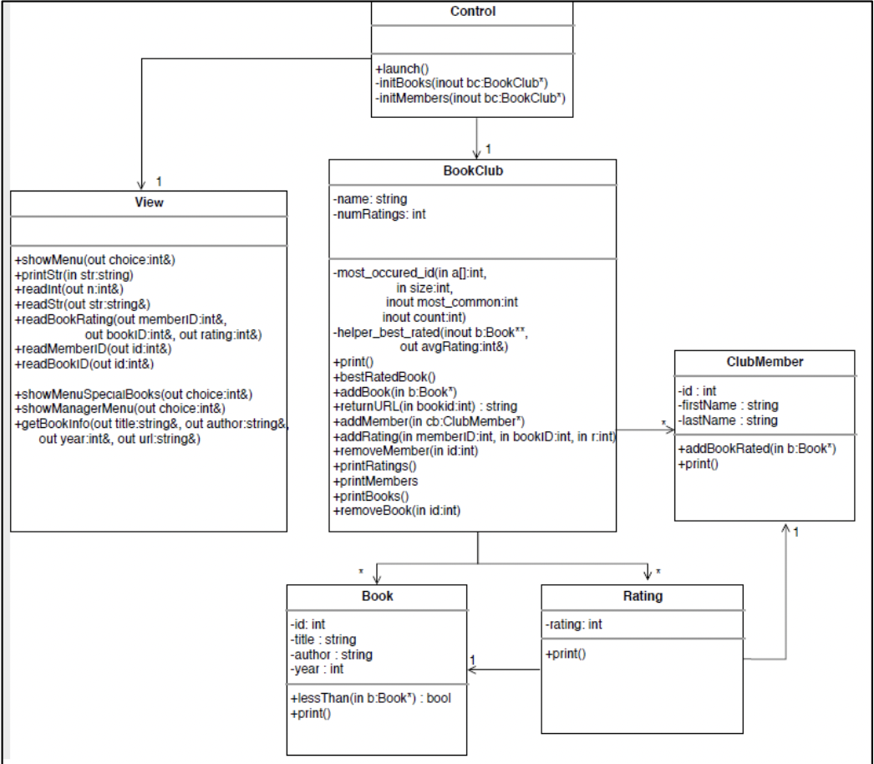
Problem Statement & Design - UML Class Diagram

Slide 8
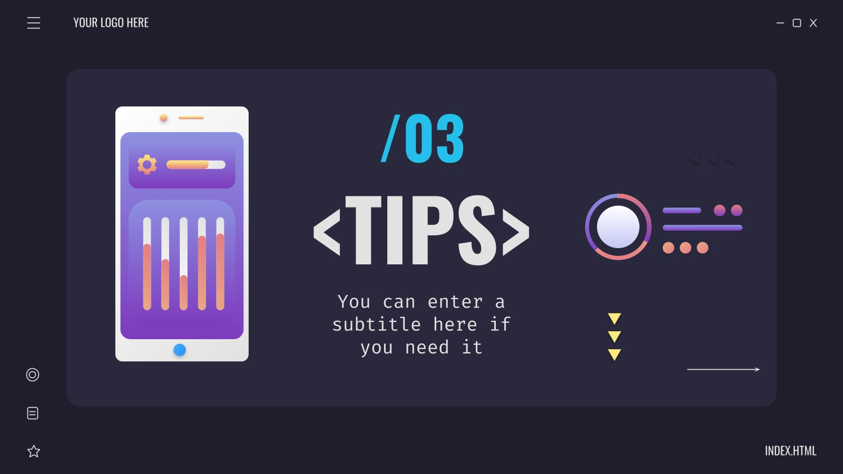

<03>
<TEST DRIVER>
Test Driver

Slide 9
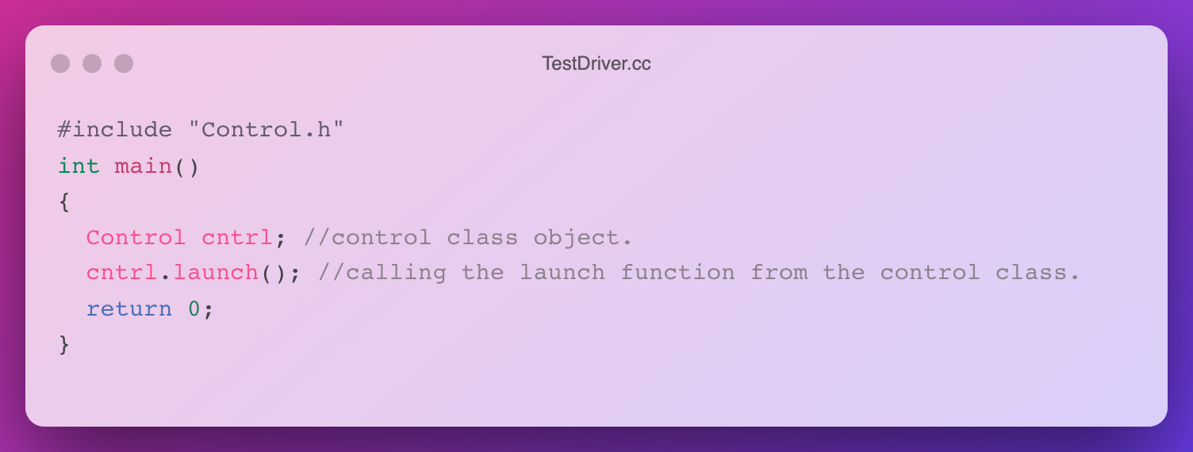
TestDriver.cc

Slide 10
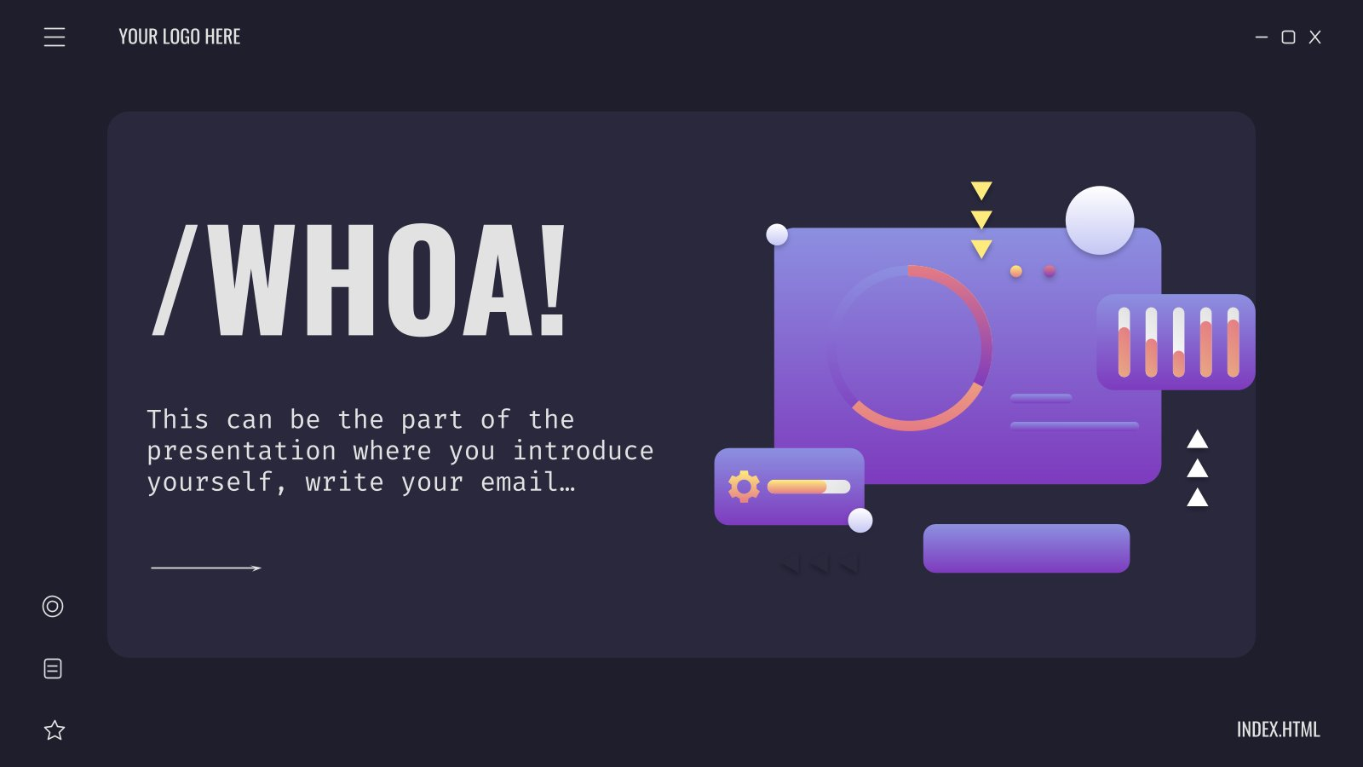
/04
/CONTROL CLASS
Control Class

Slide 11
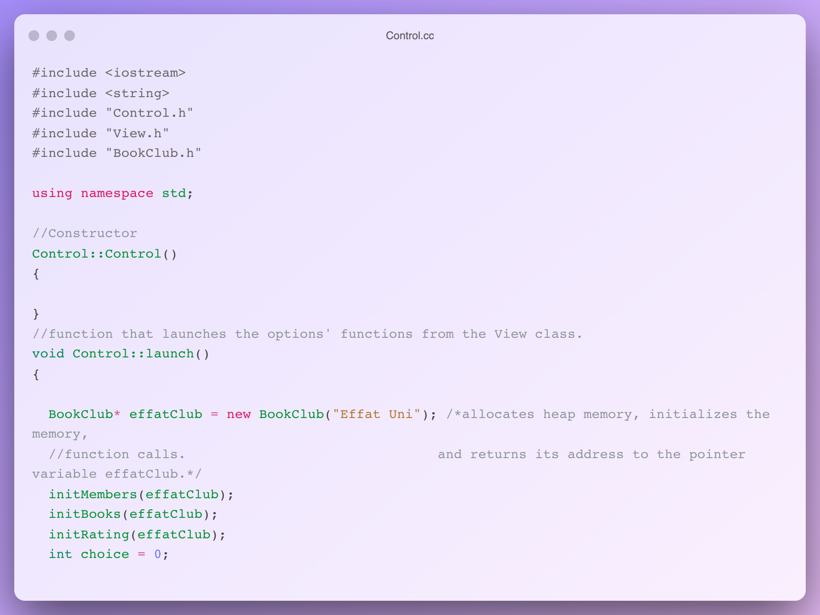
Control.cc

Slide 12
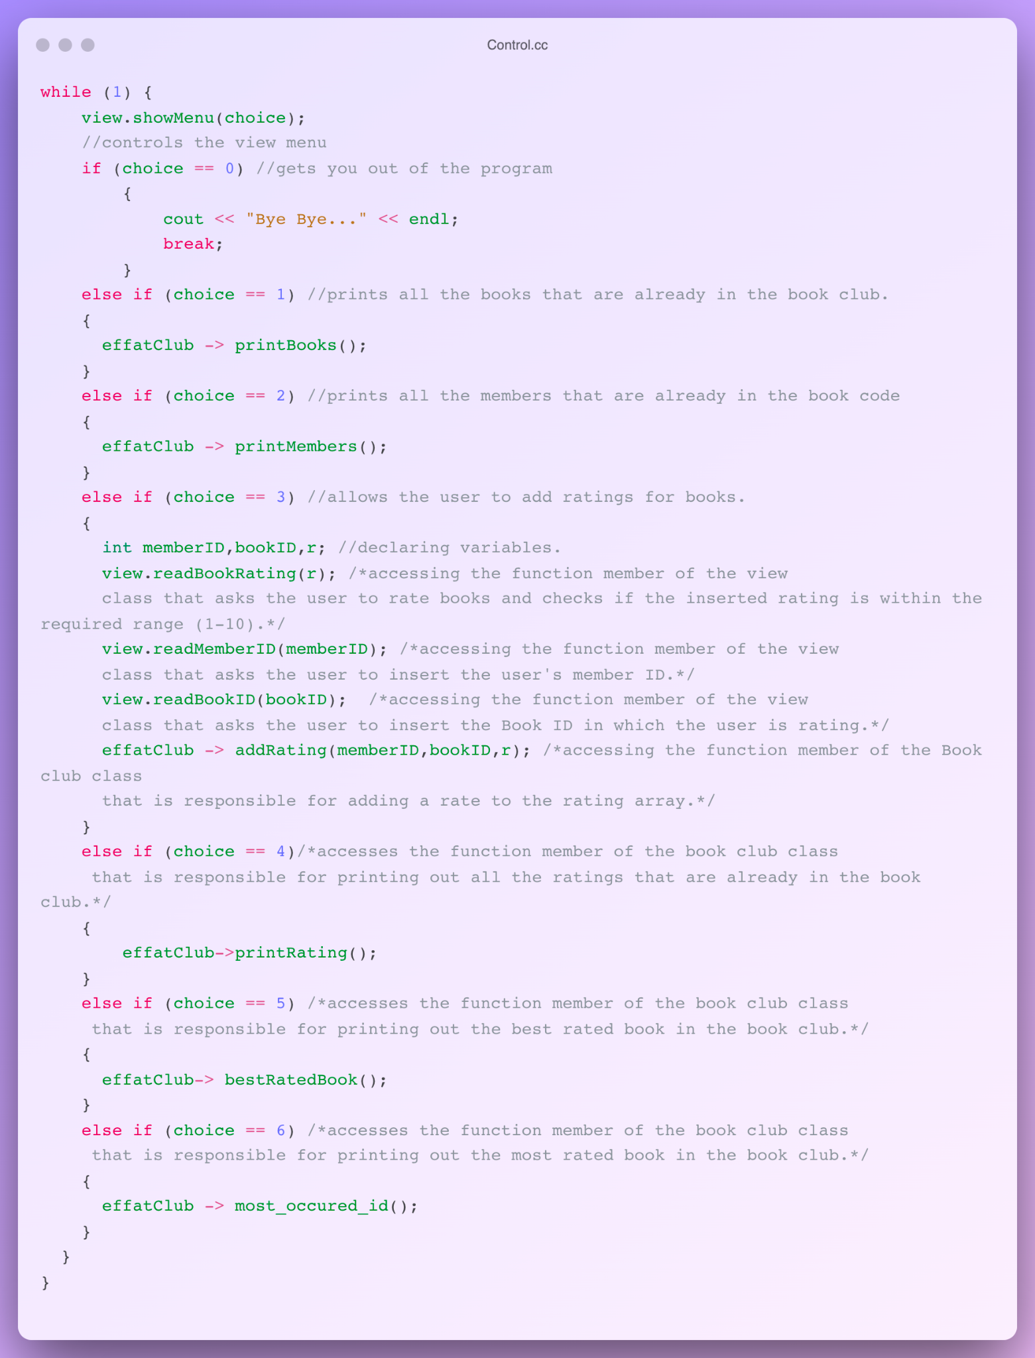
Control.cc

Slide 13
Control.cc

Slide 14
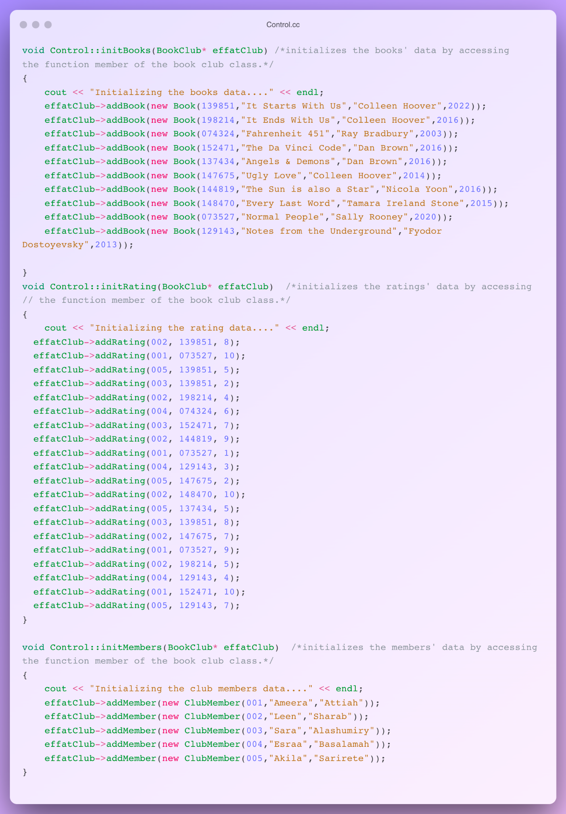
Control.cc

Slide 15
Control.cc

Slide 16
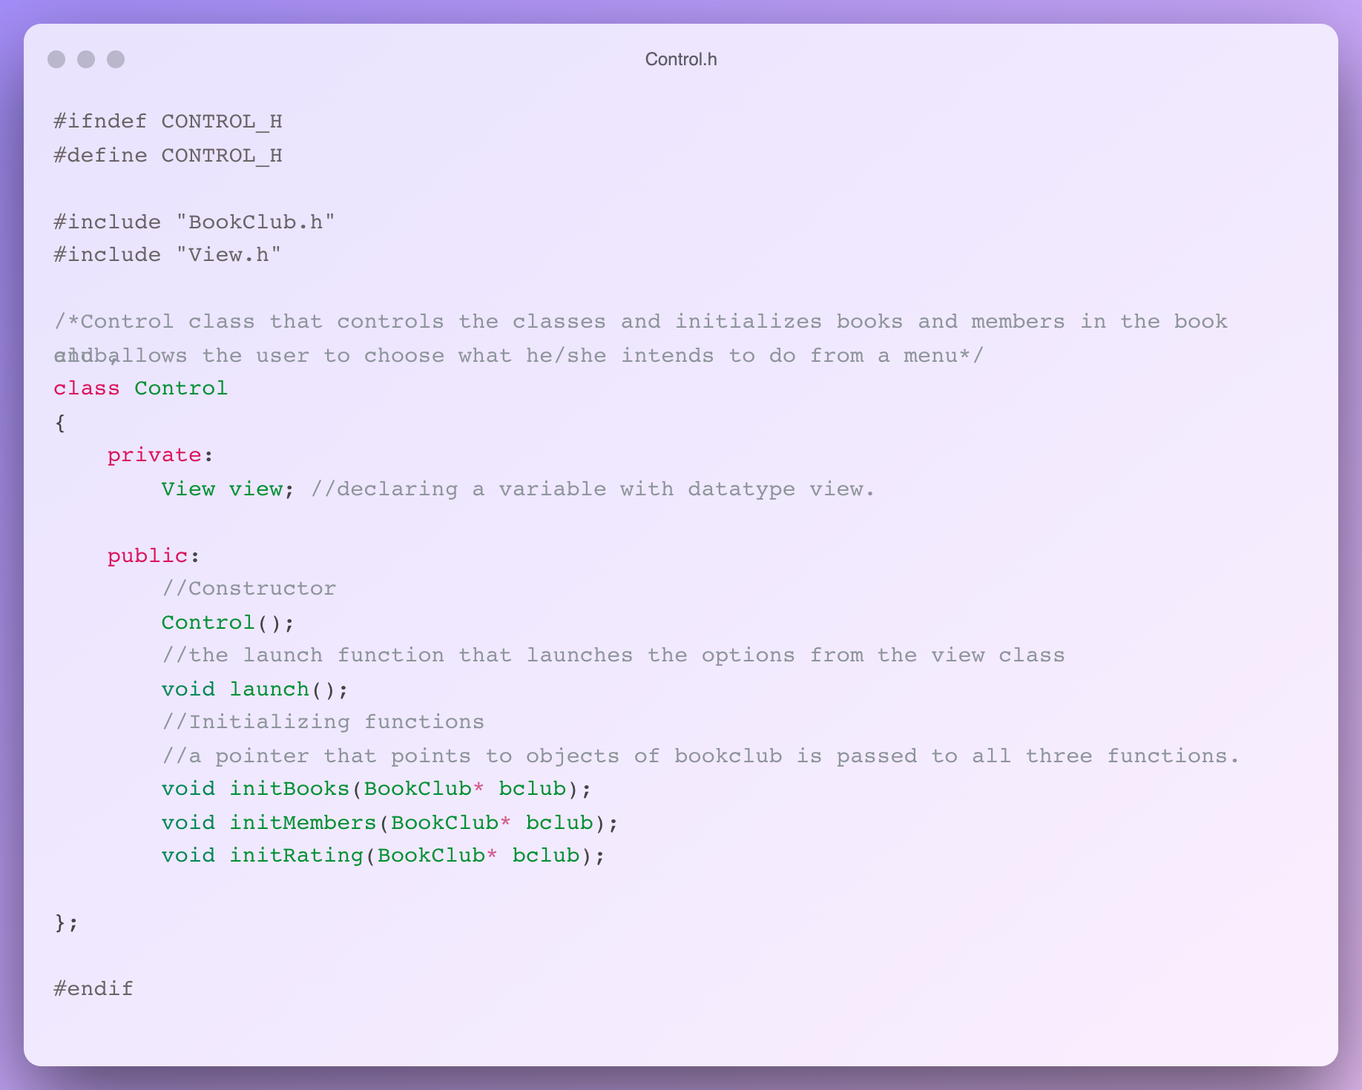
Control.h

Slide 17
<05>
<VIEW CLASS>
View Class

Slide 18
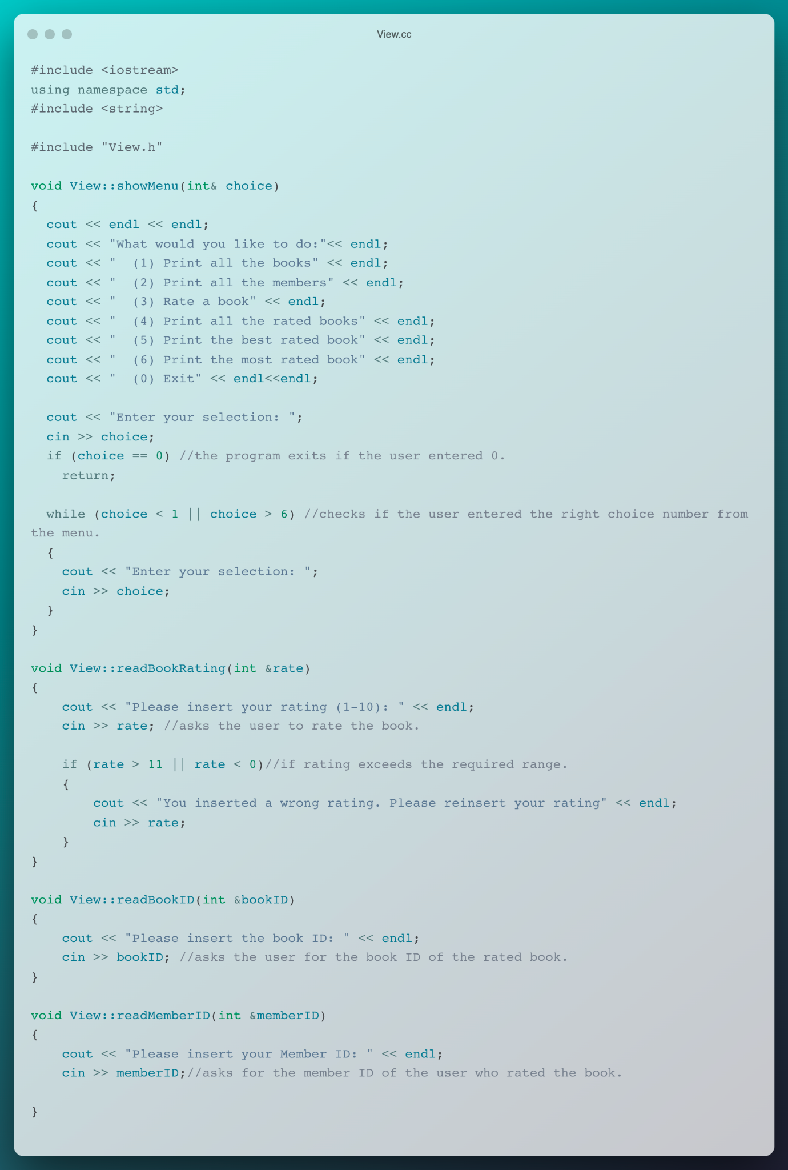
View.cc

Slide 19
View.cc

Slide 20
View.cc

Slide 21
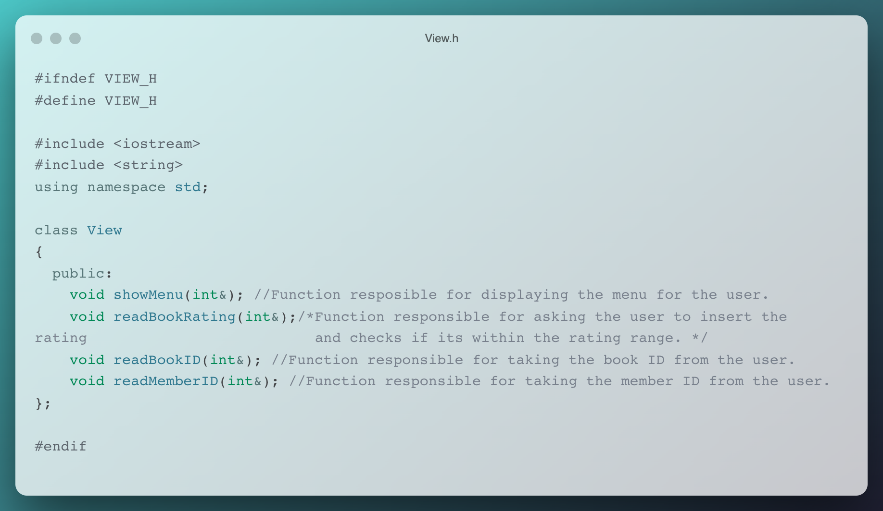
View.h

Slide 22
/06
/BOOK CLASS
Book Class

Slide 23
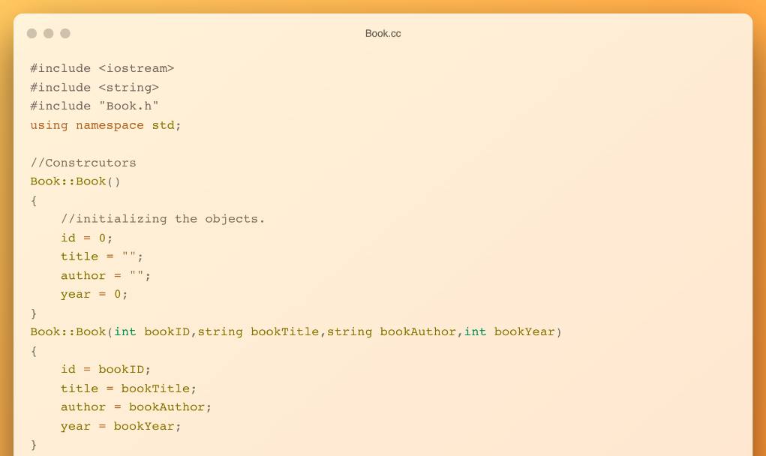
Book.cc

Slide 24
Book.cc

Slide 25
Book.cc

Slide 26
Book.cc

Slide 27
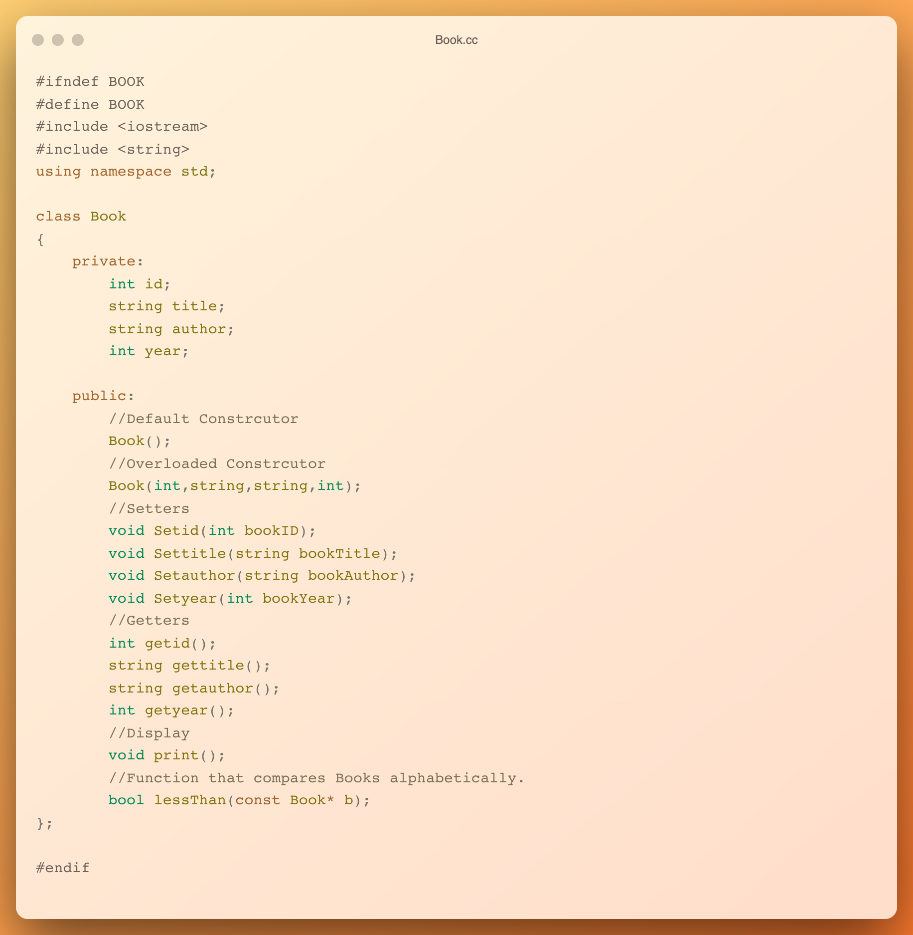
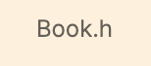
Book.h

Slide 28
Book.h

Slide 29

/07
/CLUBMEMBER CLASS
Club Member Class

Slide 30
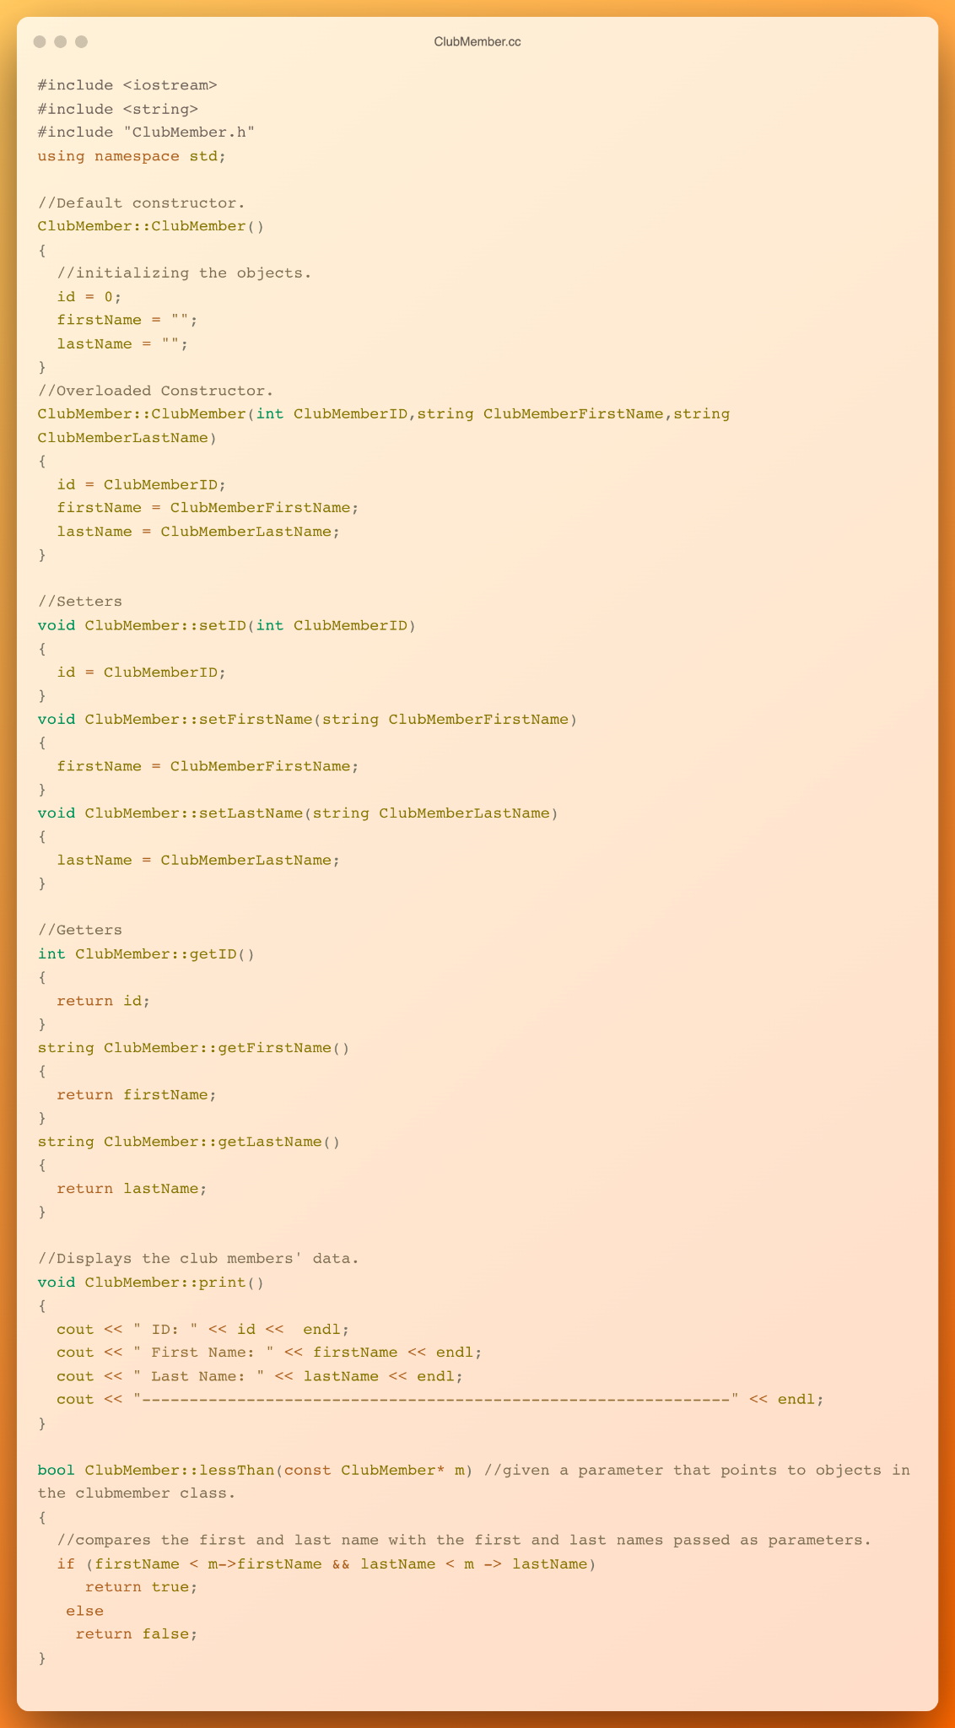
ClubMember.cc

Slide 31
ClubMember.cc

Slide 32
ClubMember.cc

Slide 33
ClubMember.cc

Slide 34
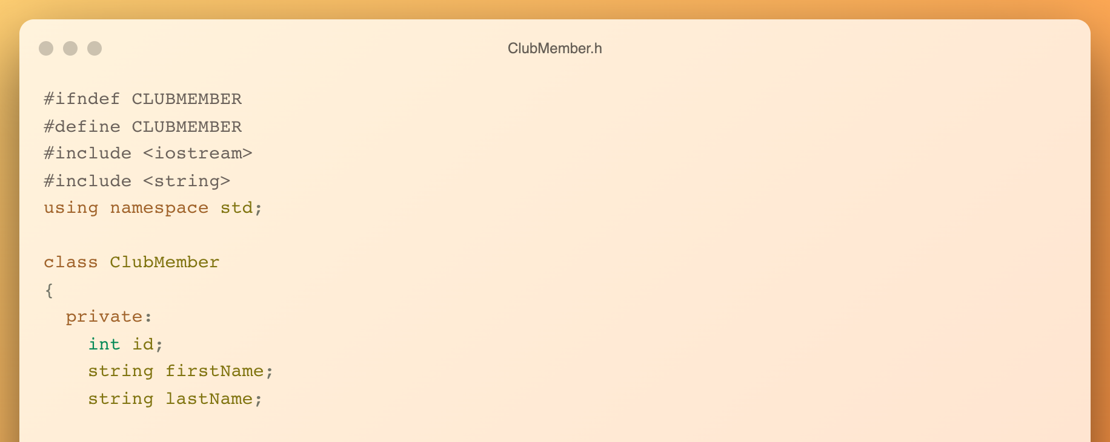
ClubMember.h

Slide 35
ClubMember.h

Slide 36
<08>
<BOOK ARRAY CLASS>
Book Array Class

Slide 37
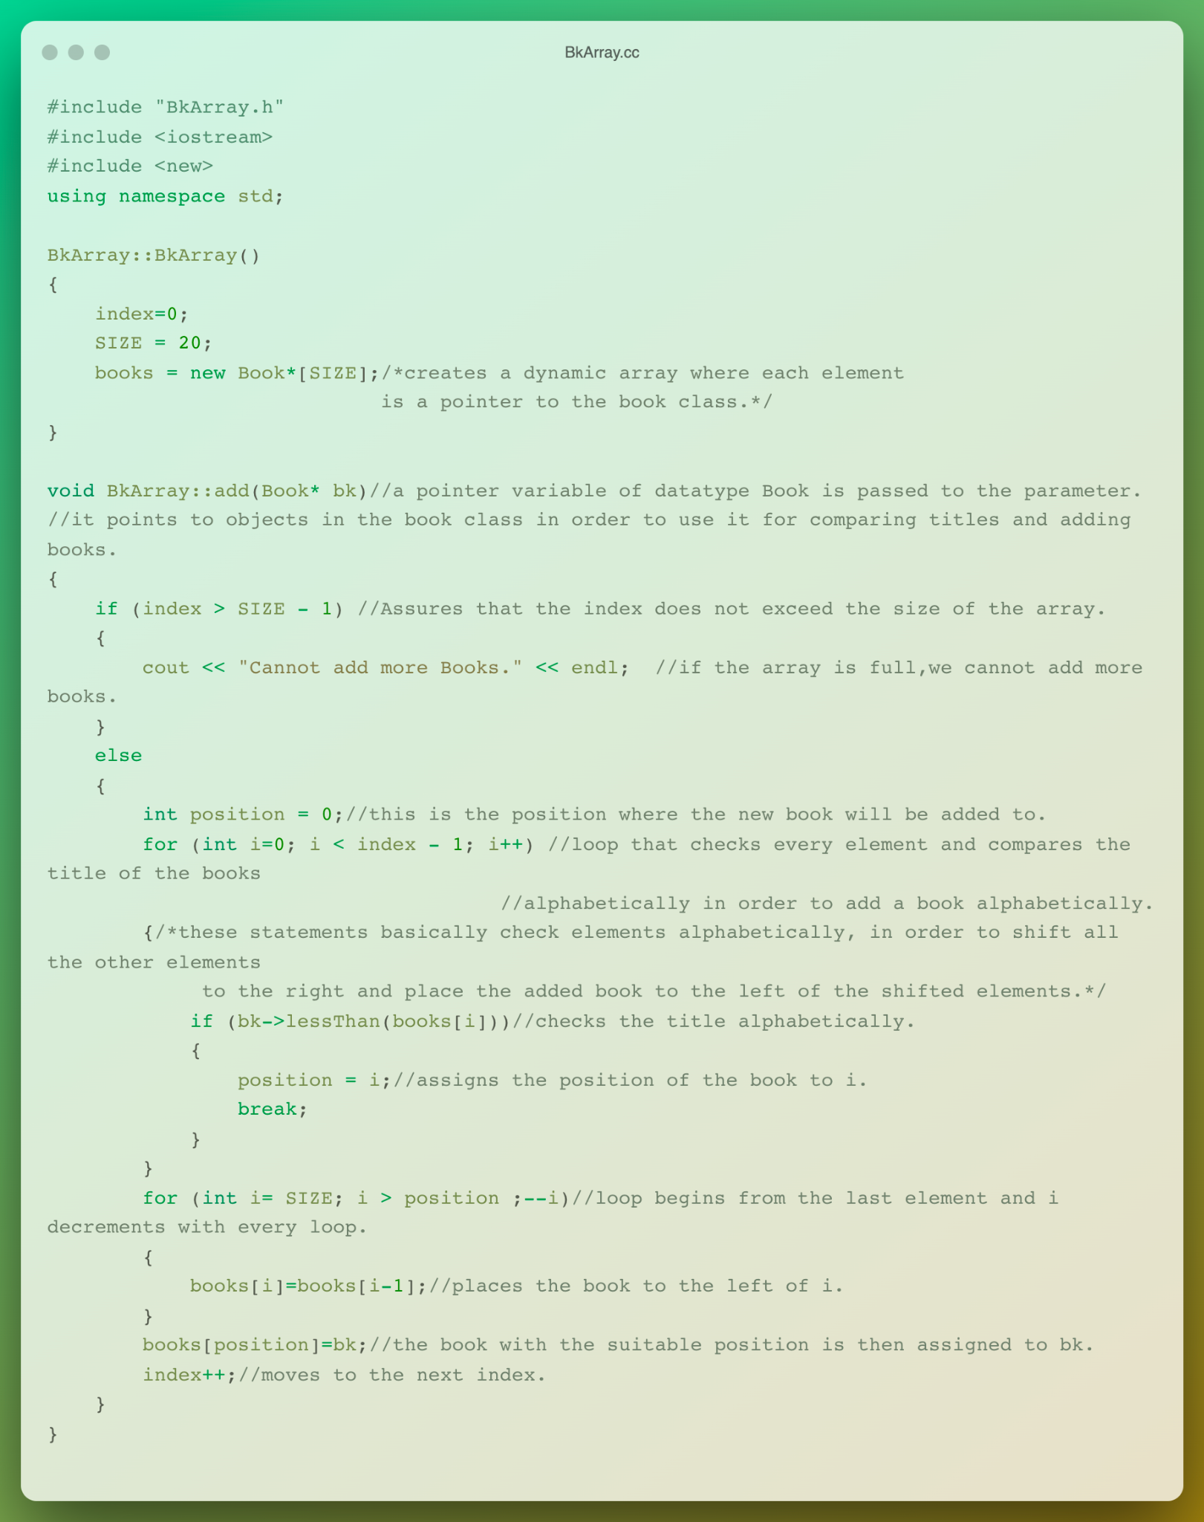
BkArray.cc

Slide 38
BkArray.cc

Slide 39
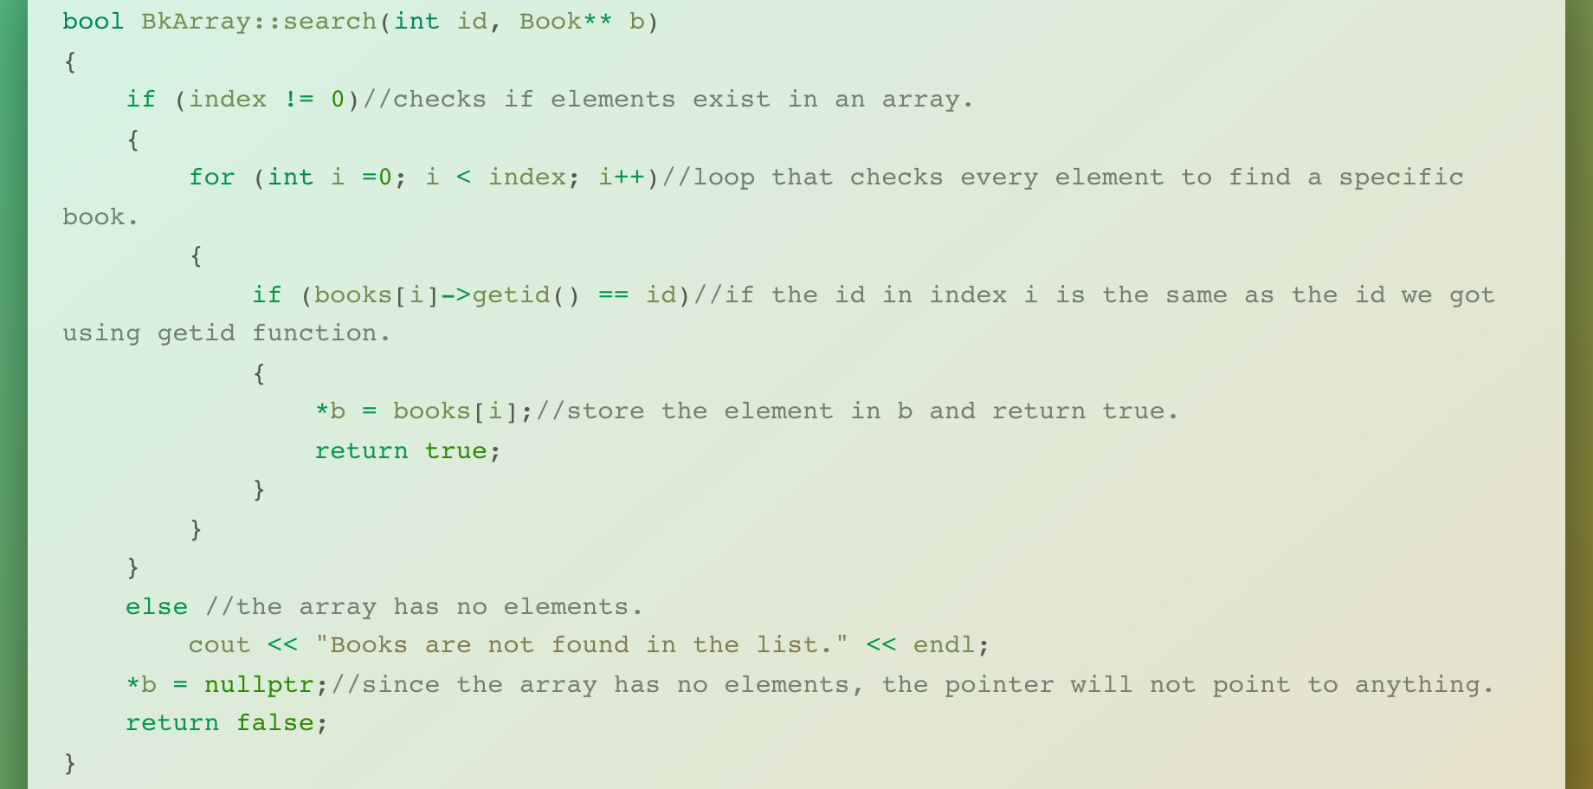
BkArray.cc

Slide 40
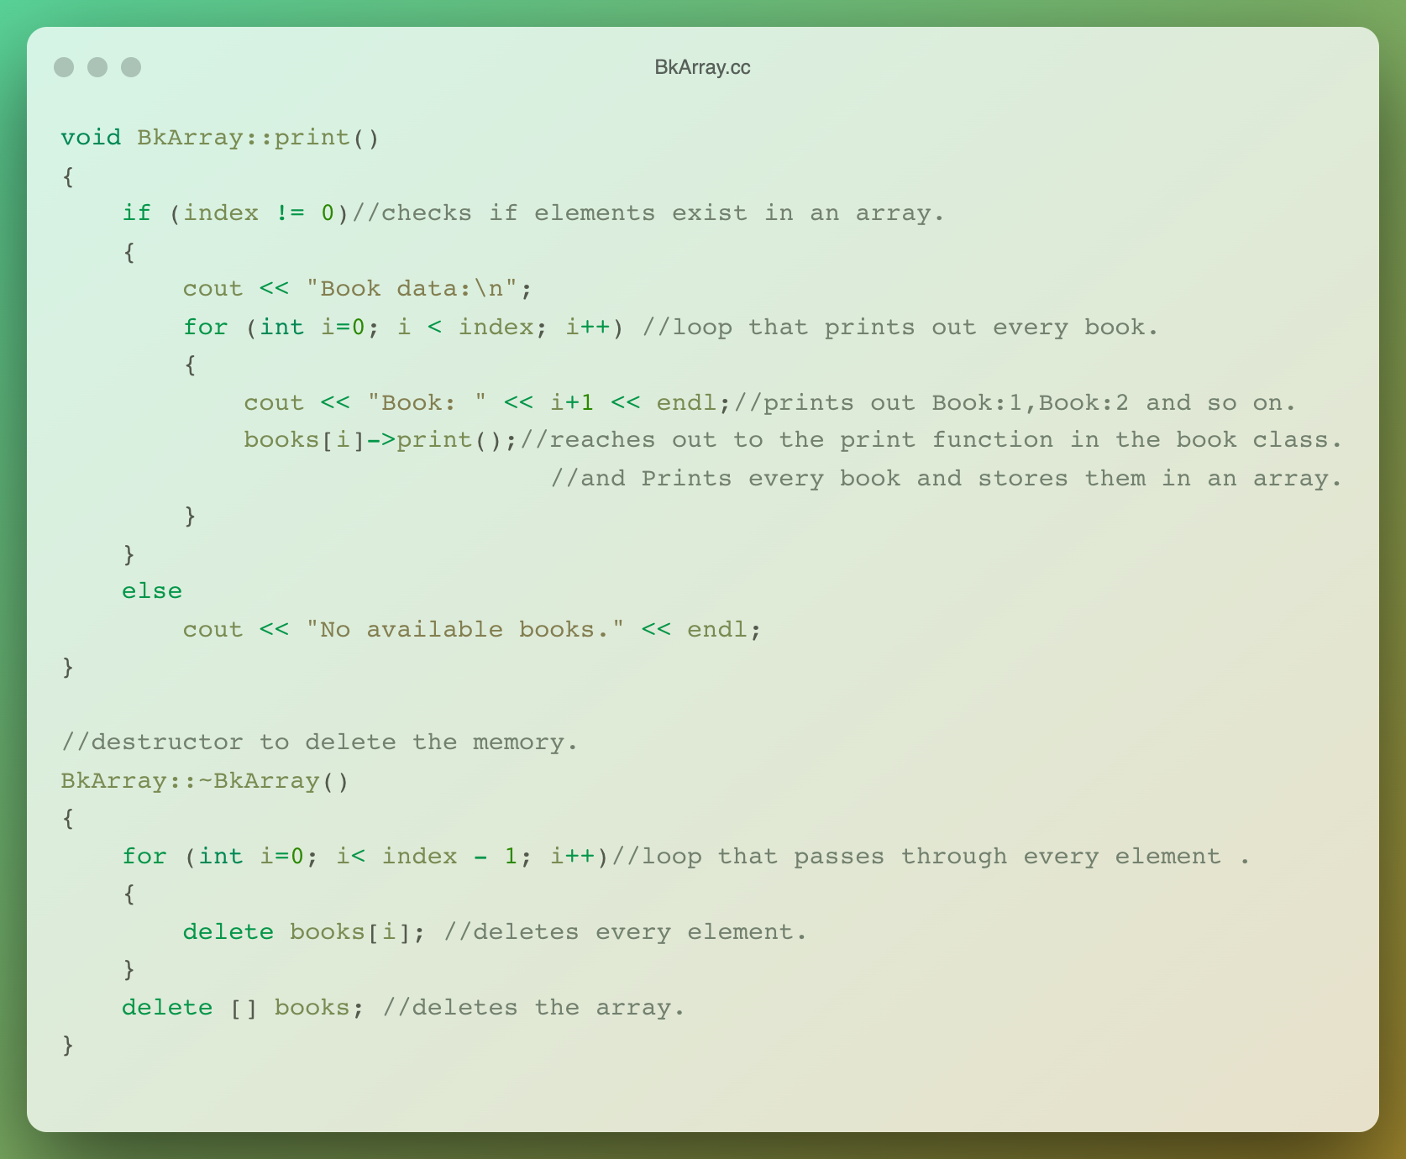
BkArray.cc

Slide 41
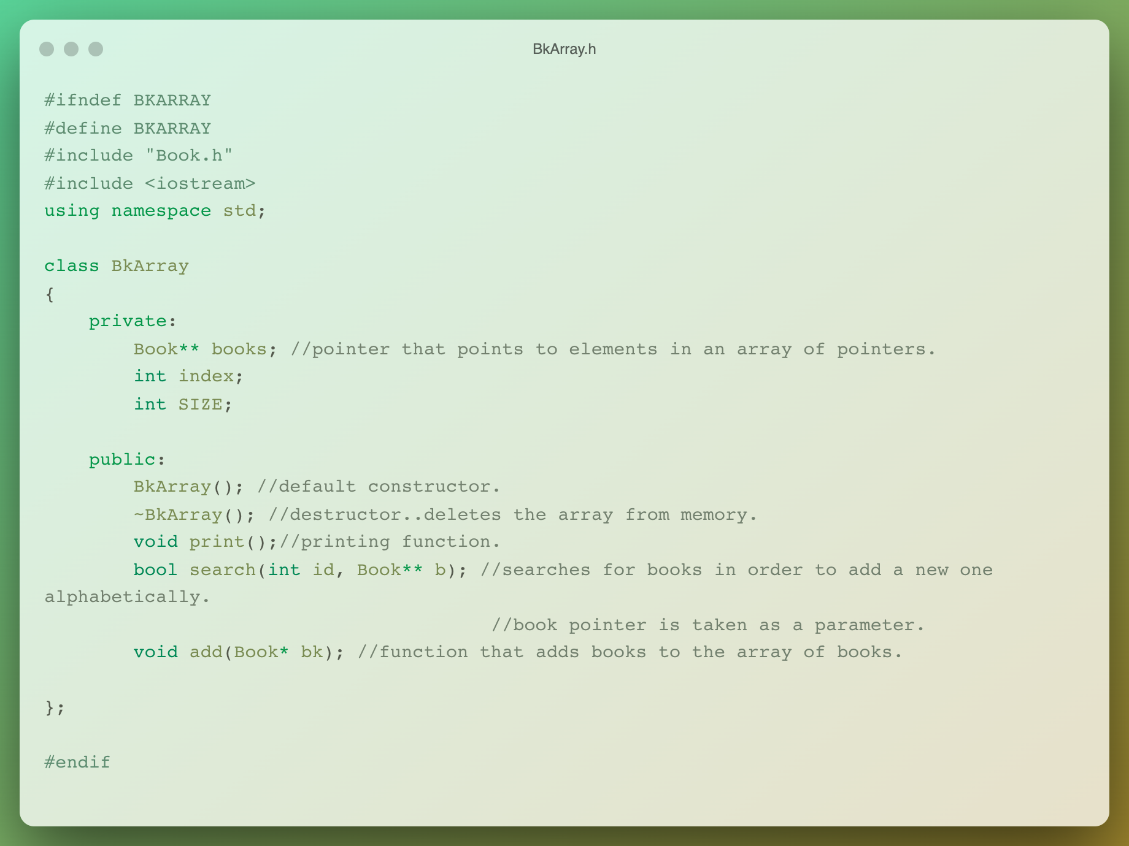
BkArray.h

Slide 42
/09
/CLUB MEMBER ARRAY CLASS
Club Member Class Array

Slide 43
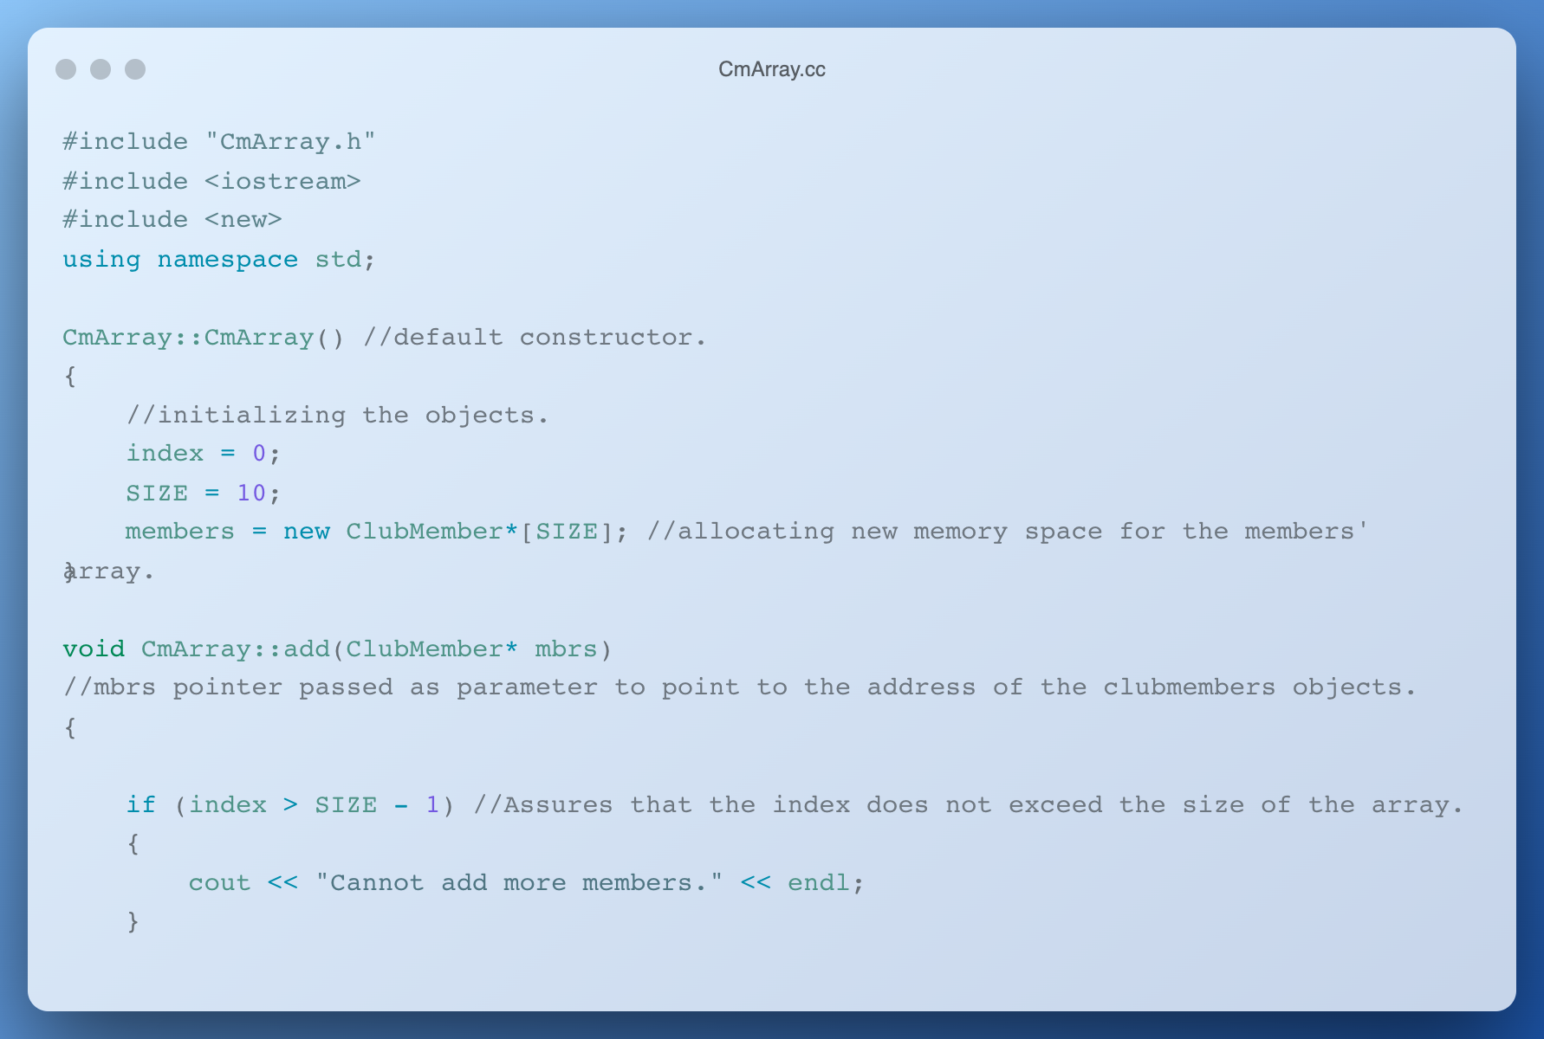
CmArray.cc

Slide 44
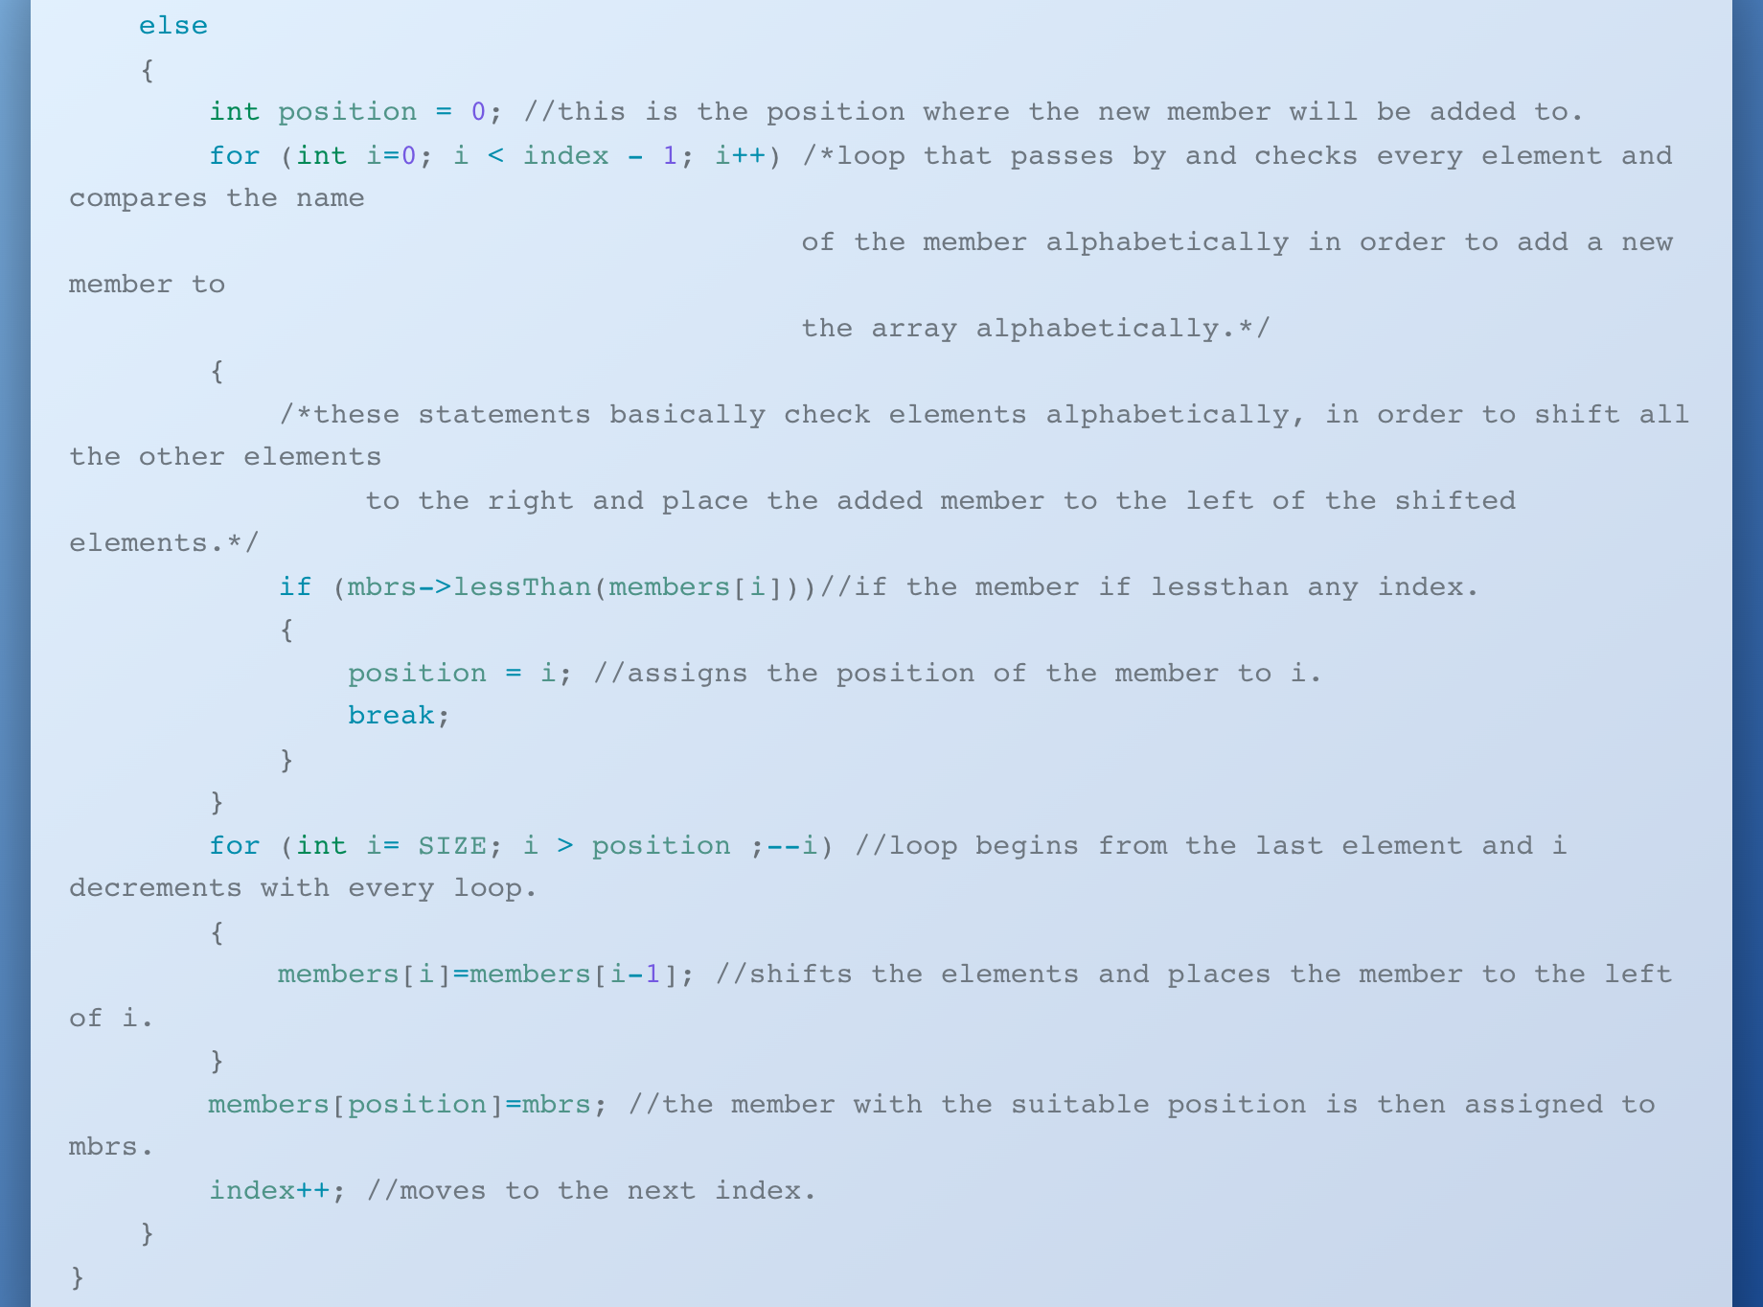
CmArray.cc

Slide 45
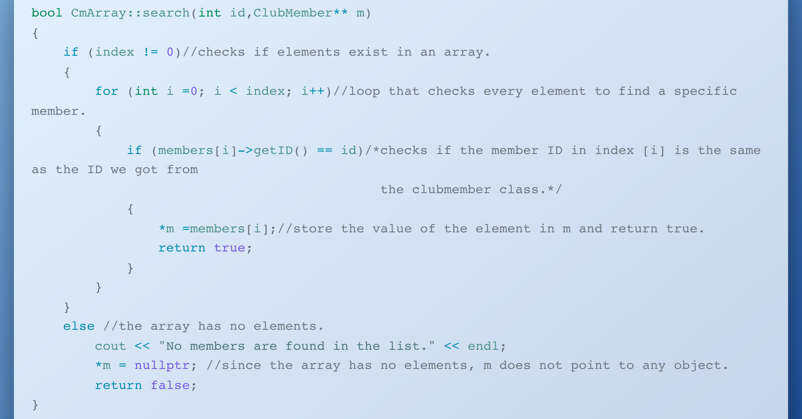
CmArray.cc

Slide 46
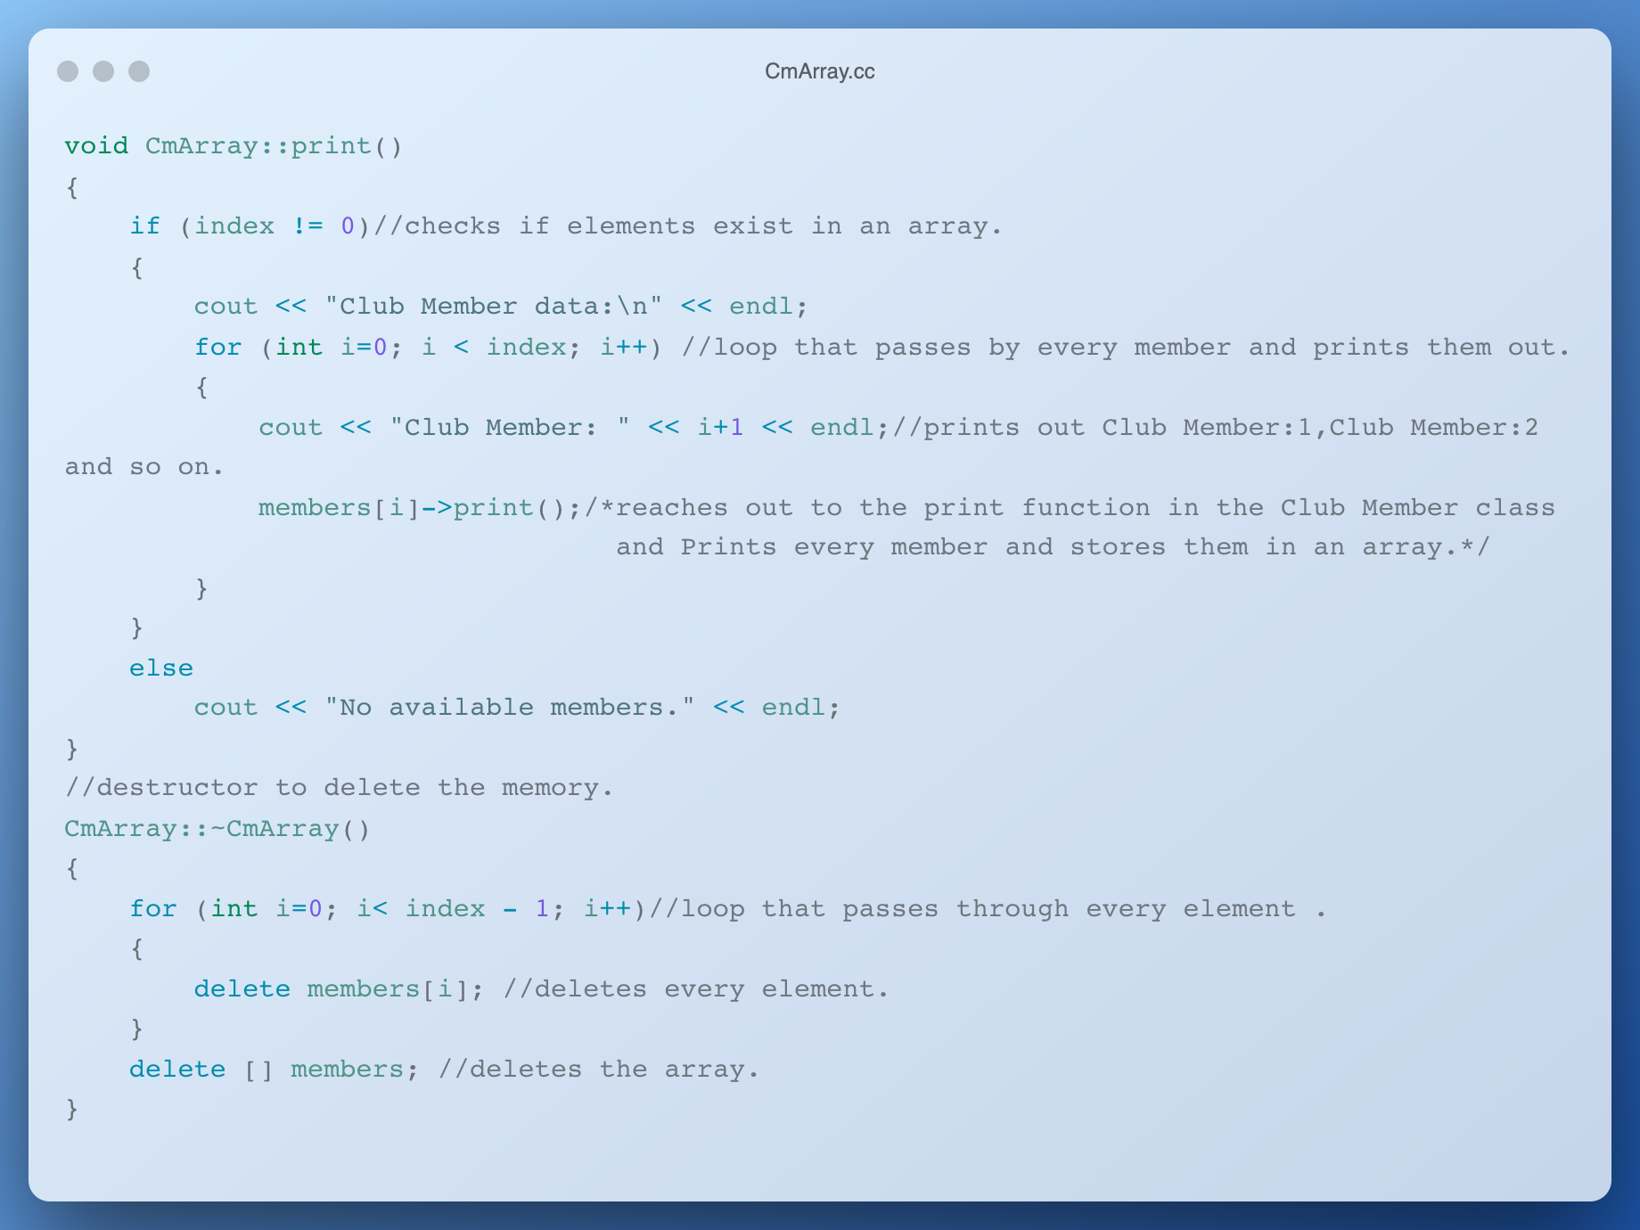
CmArray.cc

Slide 47
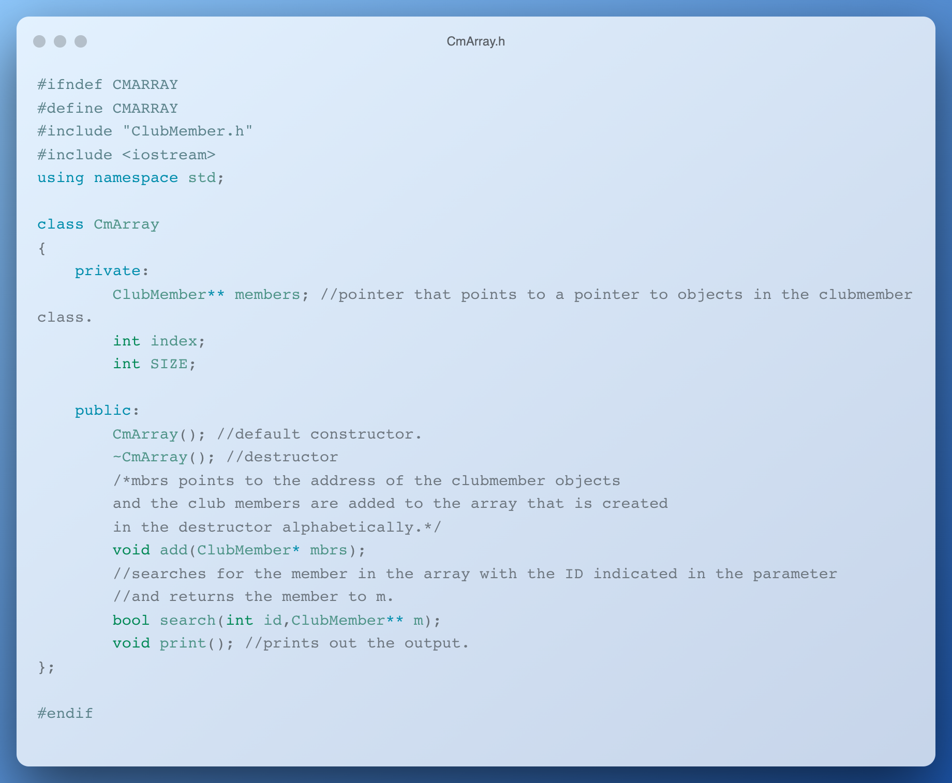
CmArray.h

Slide 48

<10>
<RATING CLASS>
YOUR LOGO HERE
Rating Class
You can enter a subtitle here if you need it

Slide 49
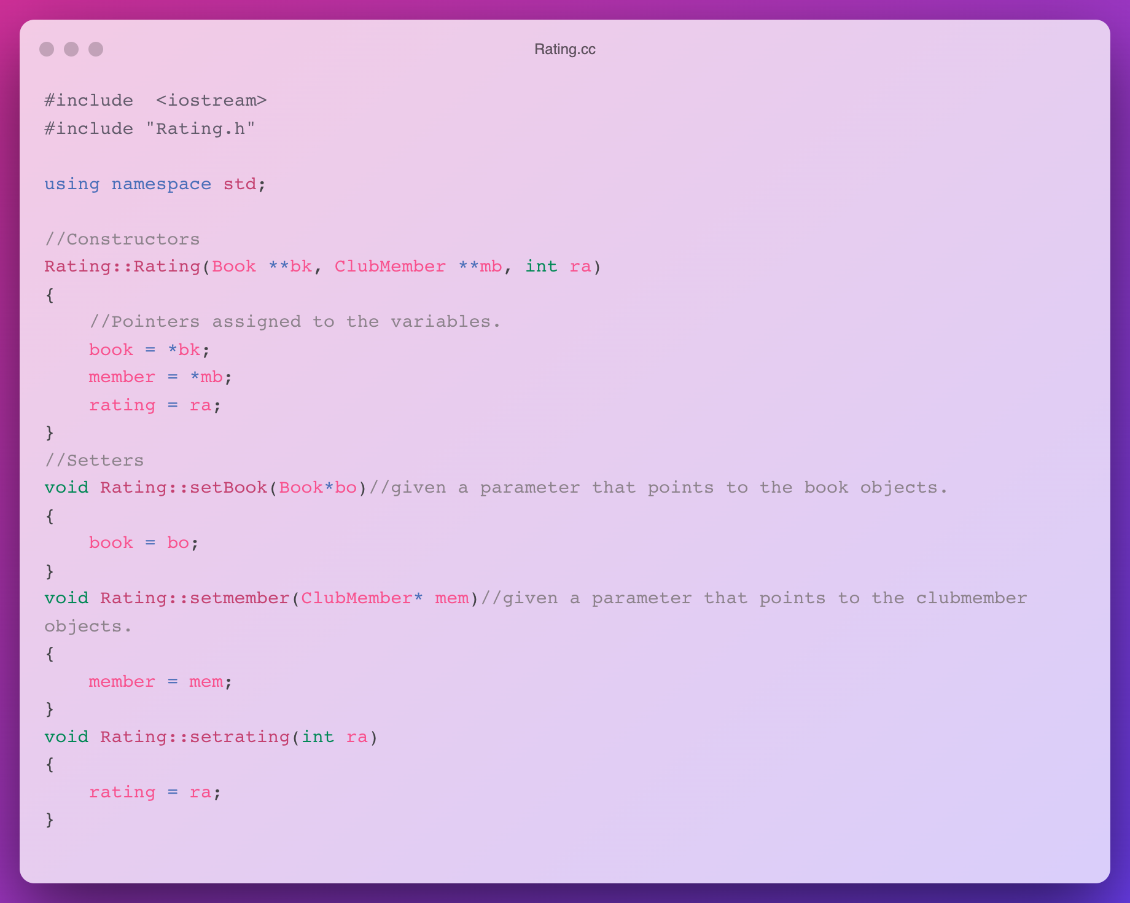
Rating.cc

Slide 50
Rating.cc

Slide 51
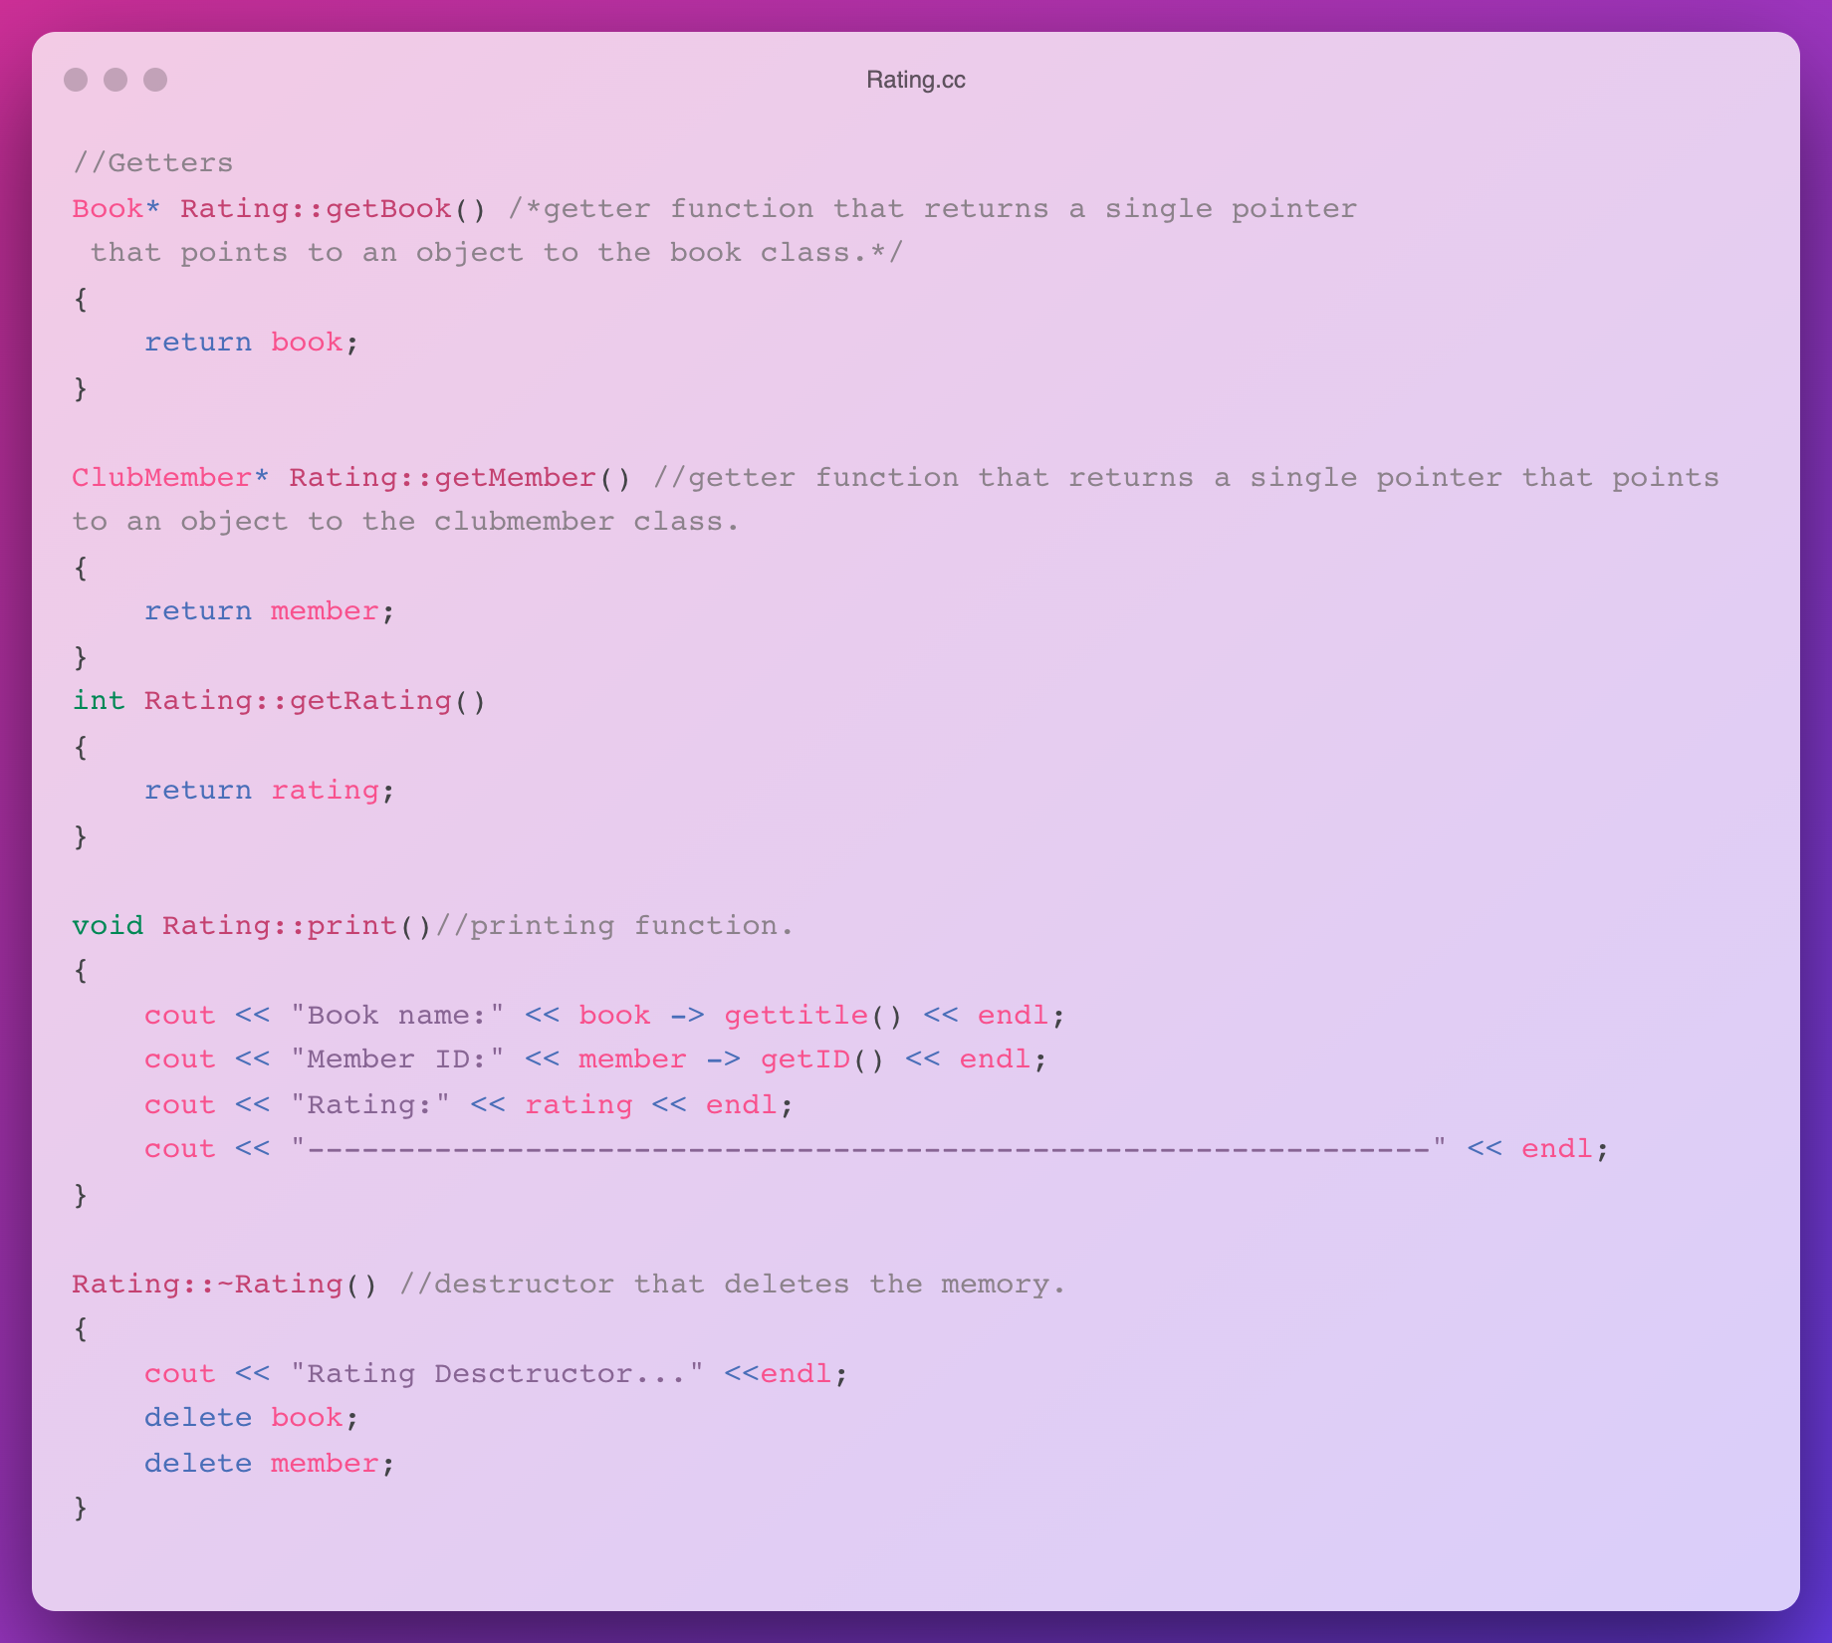
Rating.cc

Slide 52
Rating.cc

Slide 53
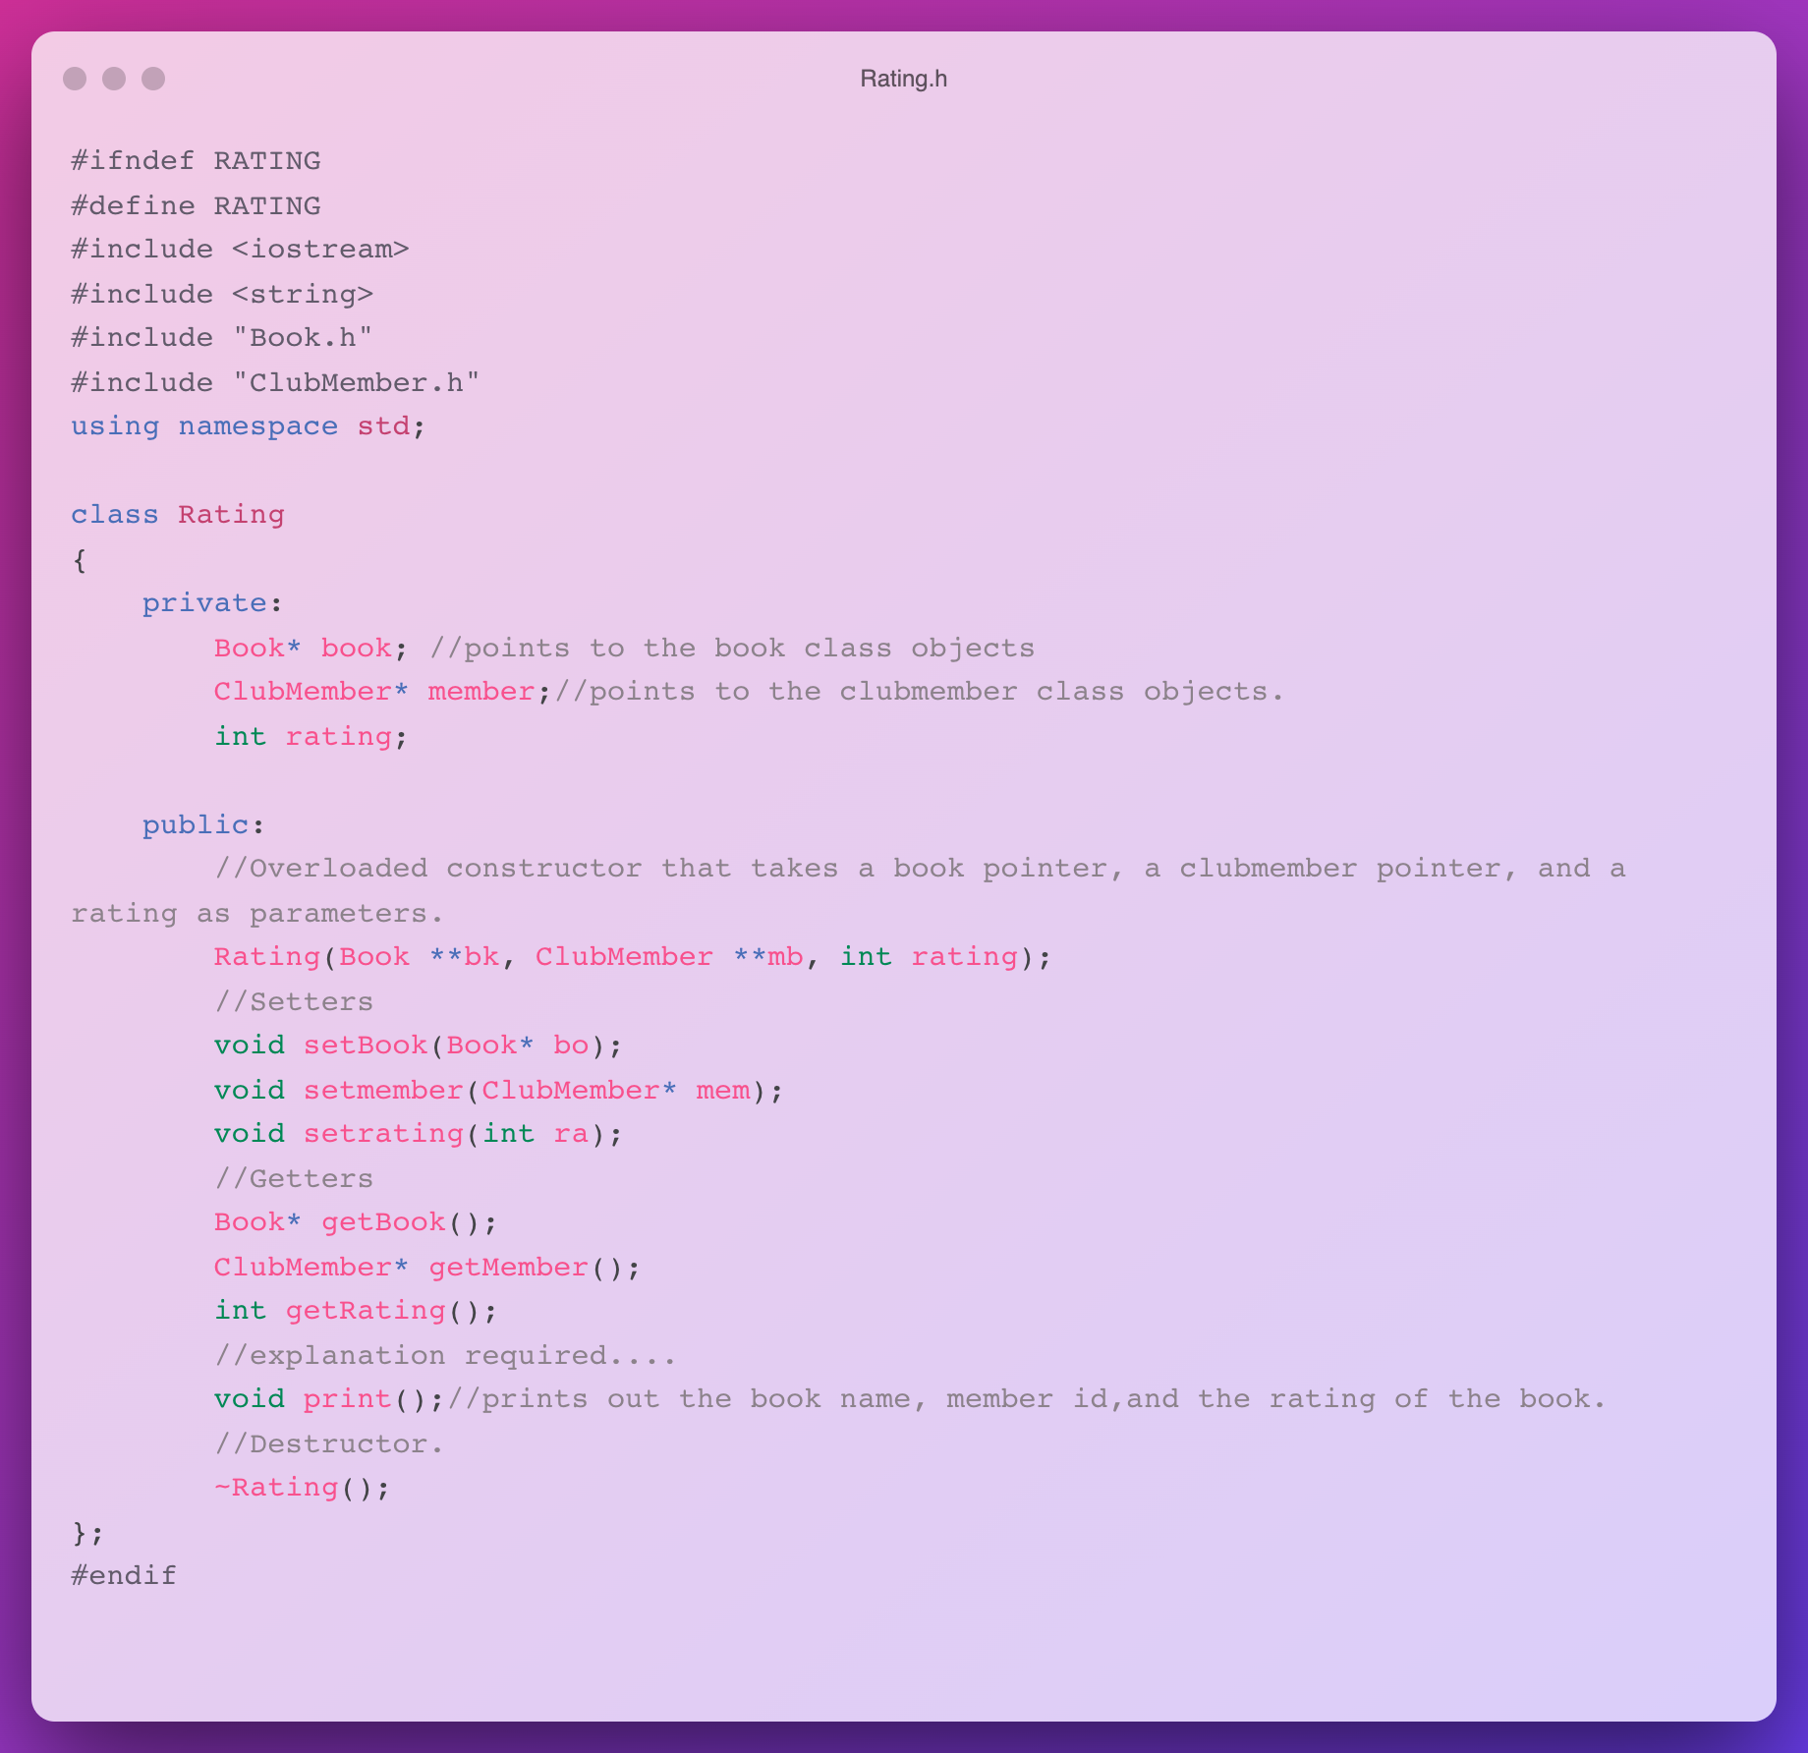
Rating.h

Slide 54
Rating.h

Slide 55
/11
/BOOK CLUB CLASS
YOUR LOGO HERE
Book Club Class

Slide 56
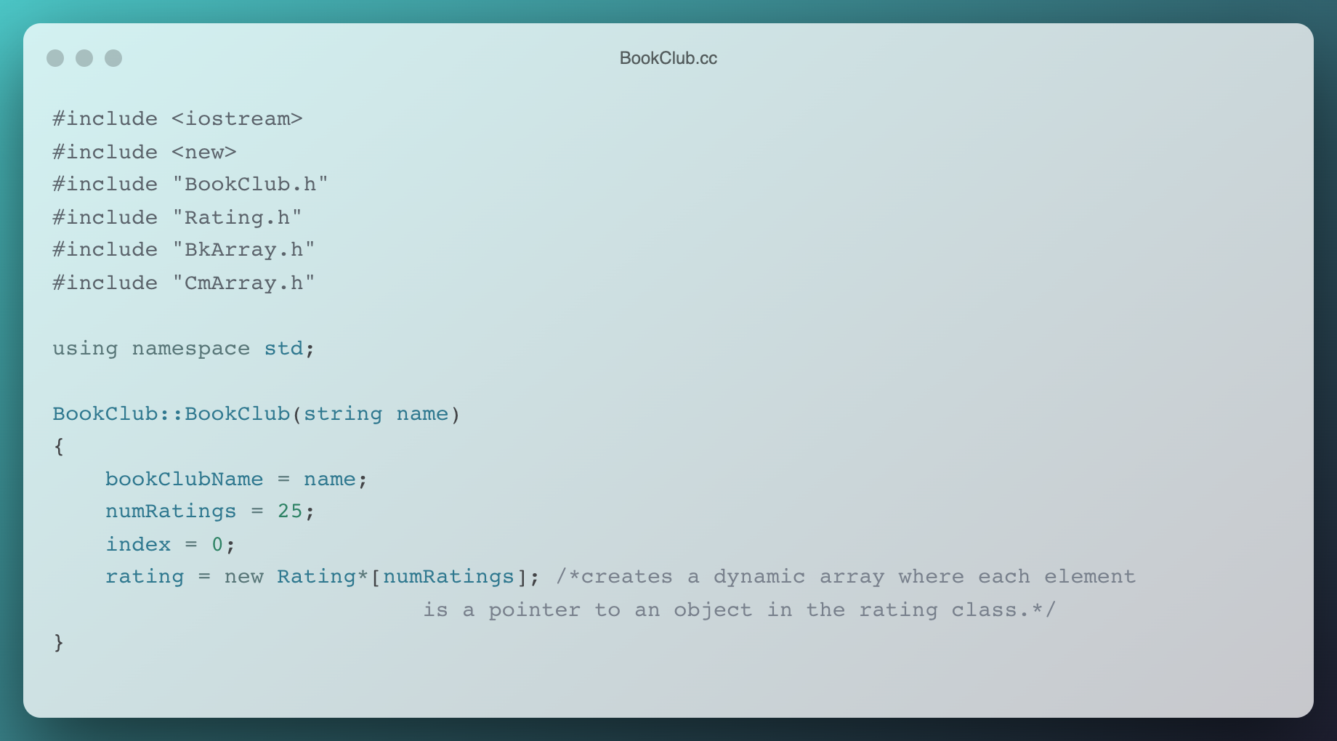
BookClub.cc

Slide 57
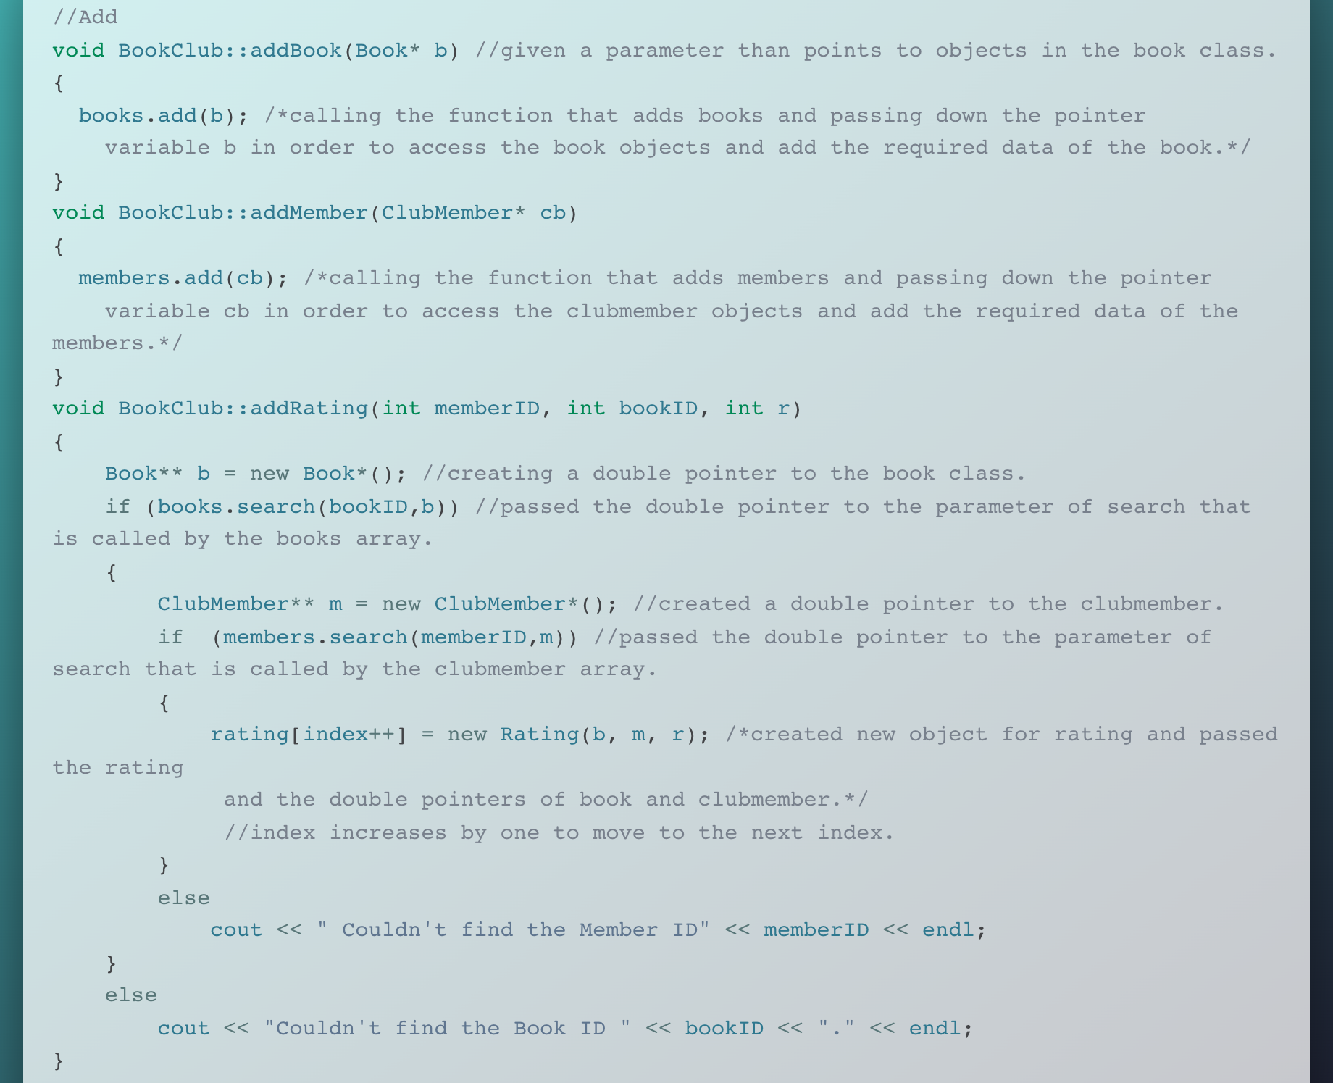
BookClub.cc

Slide 58
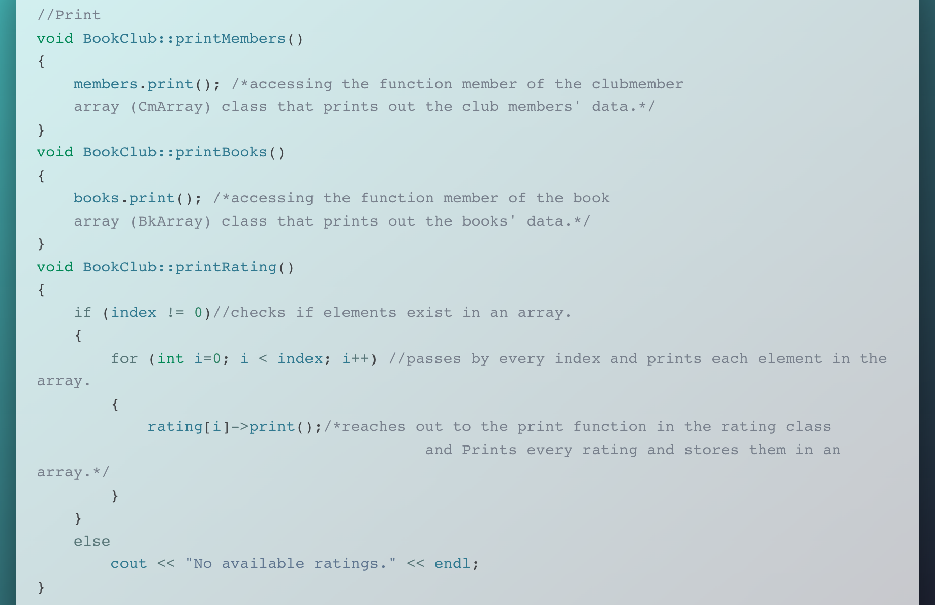
BookClub.cc

Slide 59
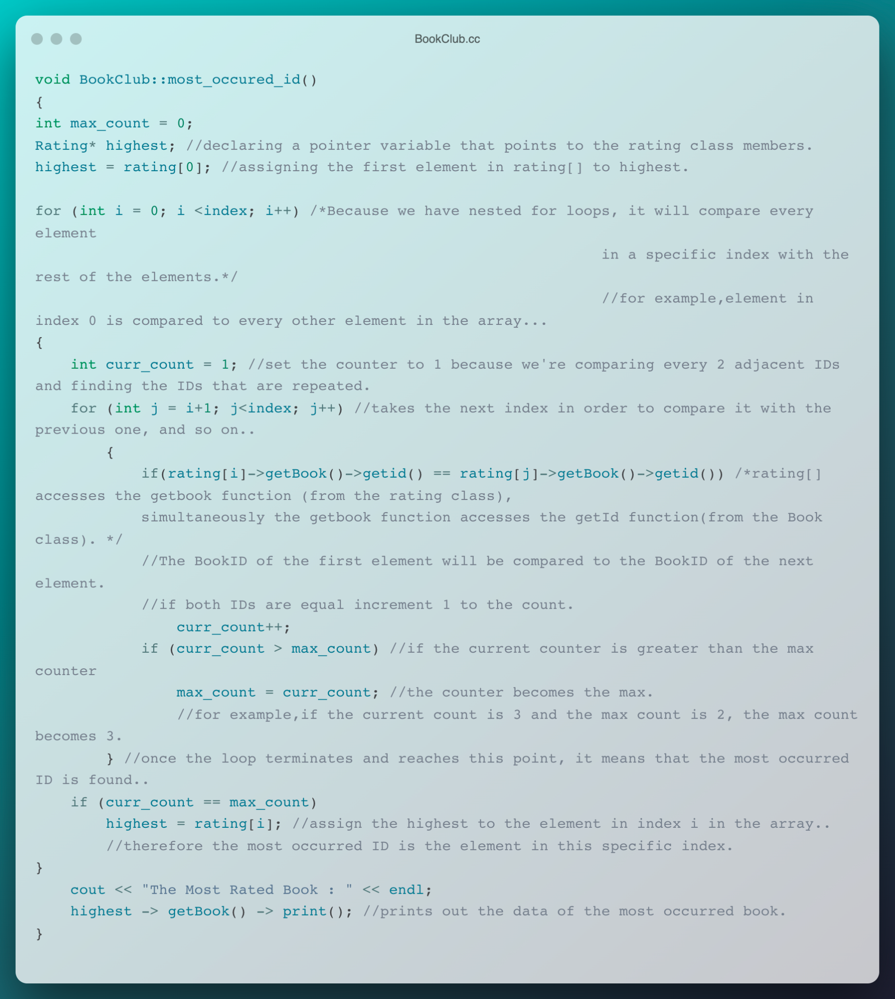
BookClub.cc

Slide 60
BookClub.cc

Slide 61
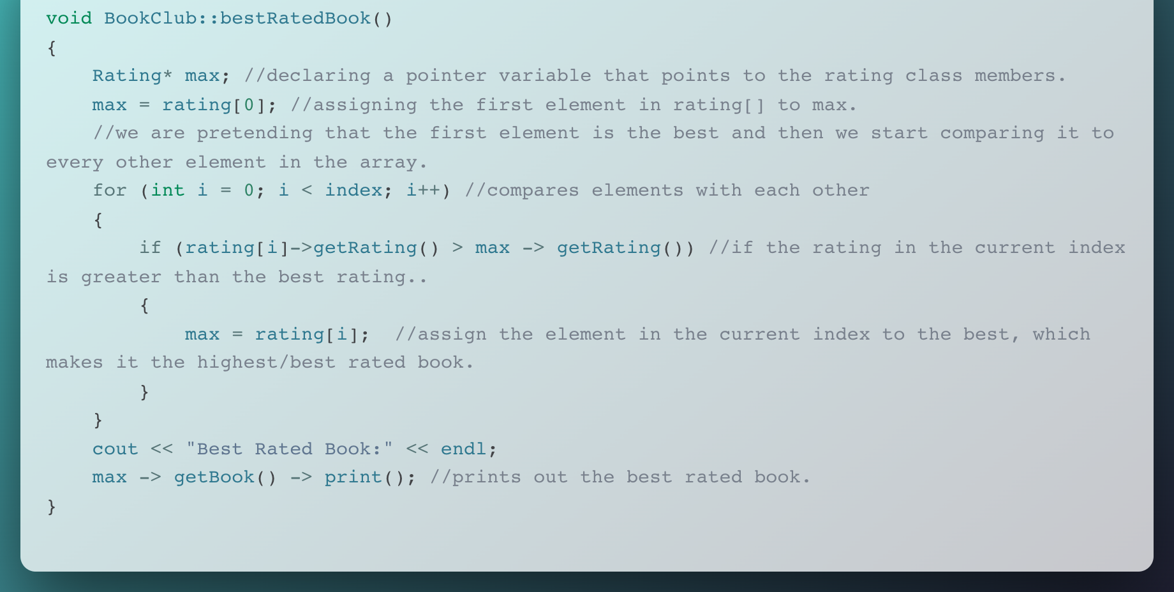
BookClub.cc

Slide 62
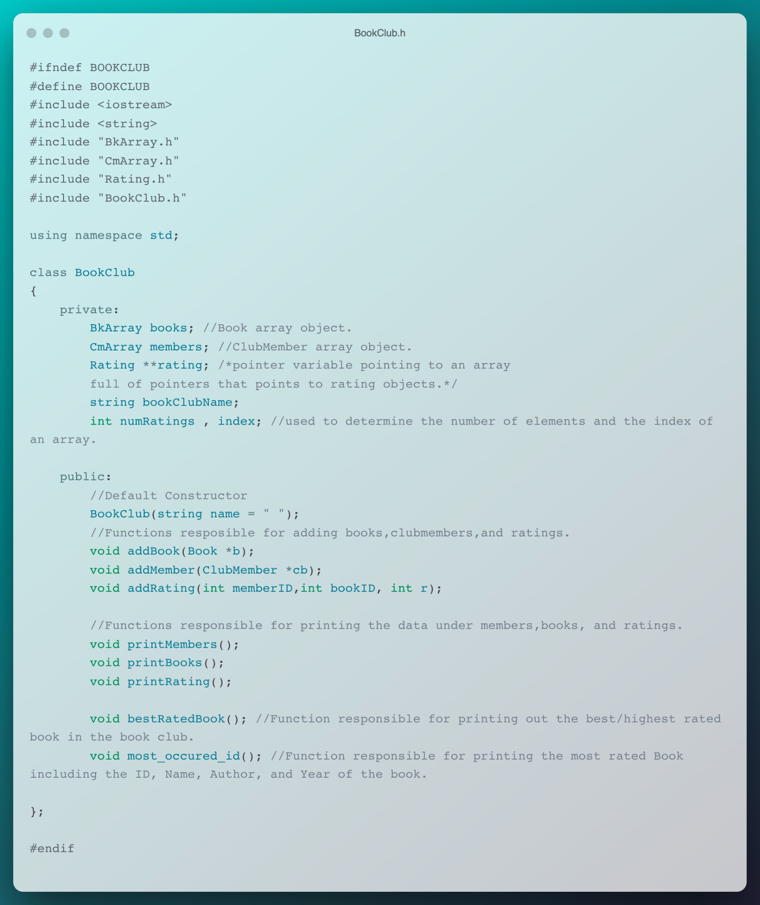
BookClub.h

Slide 63
BookClub.h

Slide 64
<12>
<MAKEFILE>
Makefile
You can enter a subtitle here if you need it

Slide 65
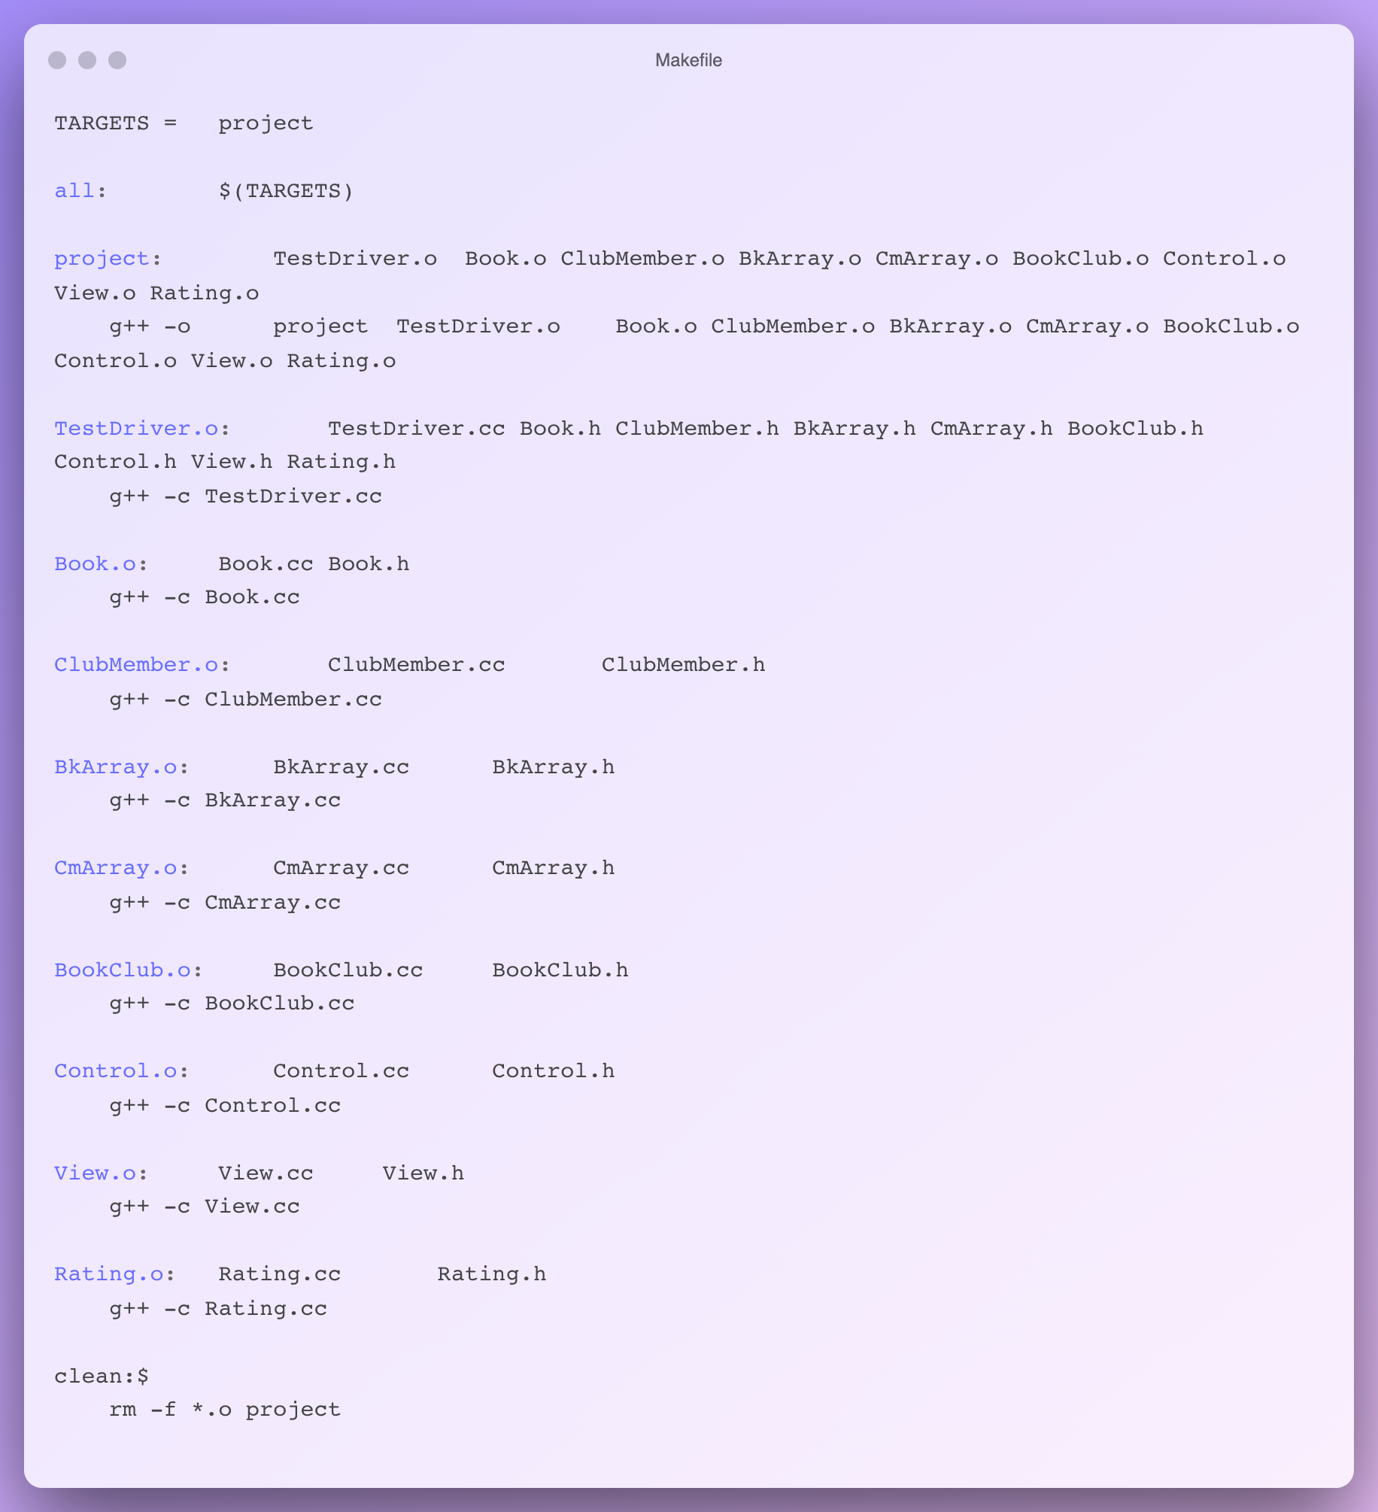
Makefile

Slide 66
Makefile

Slide 67

/13
/EXECUTION OF THE CODE
Execution of the Code
You can enter a subtitle here if you need it

Slide 68
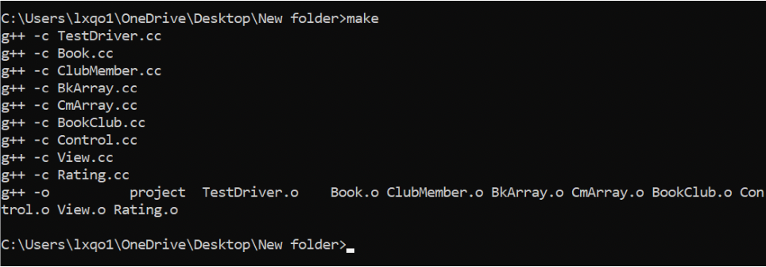
Execution of the Code

Slide 69
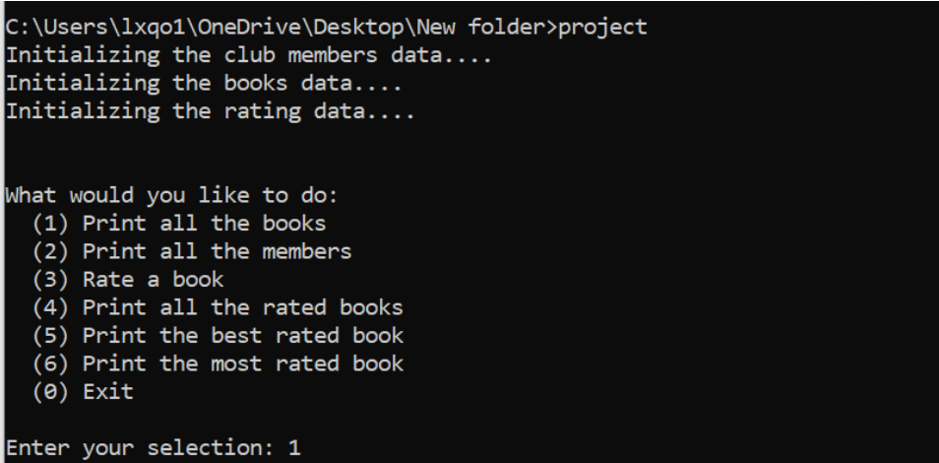
Execution of the Code

Slide 70
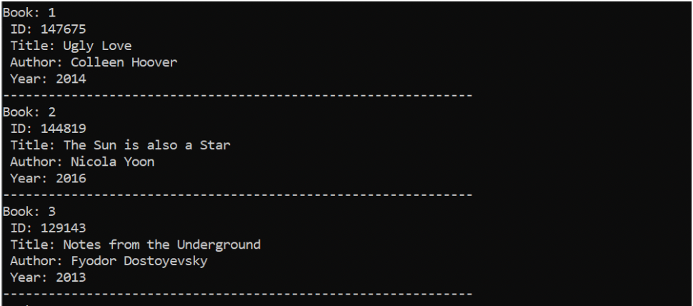
Execution of the Code - Option 1: Print all the books

Slide 71
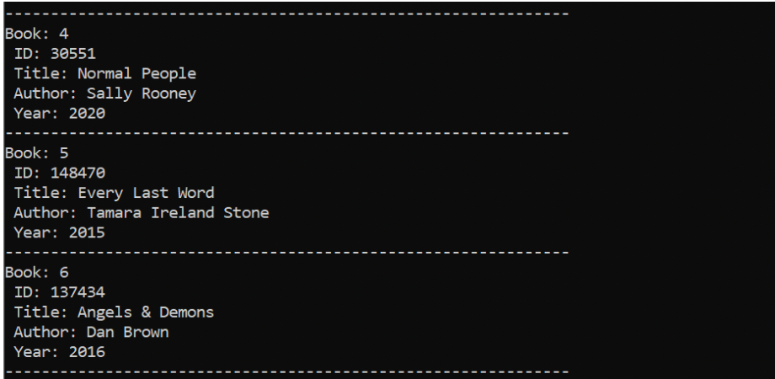
Execution of the Code - Option 1: Print all the books

Slide 72
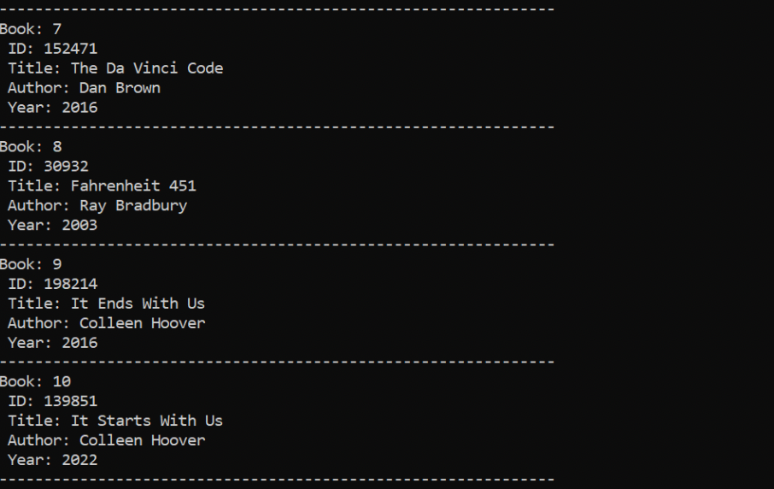
Execution of the Code - Option 1: Print all the books

Slide 73
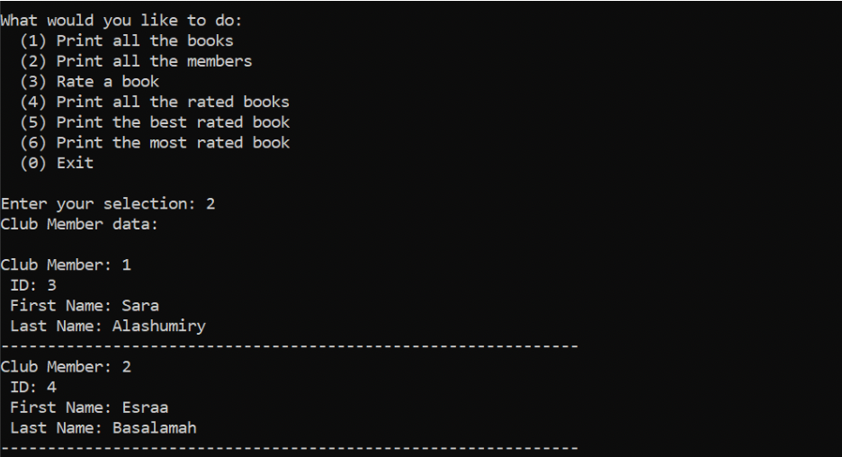
Execution of the Code - Option 2: Print all the members

Slide 74
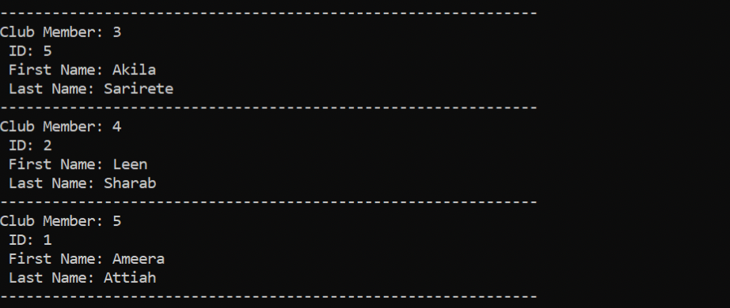
Execution of the Code - Option 2: Print all the members

Slide 75
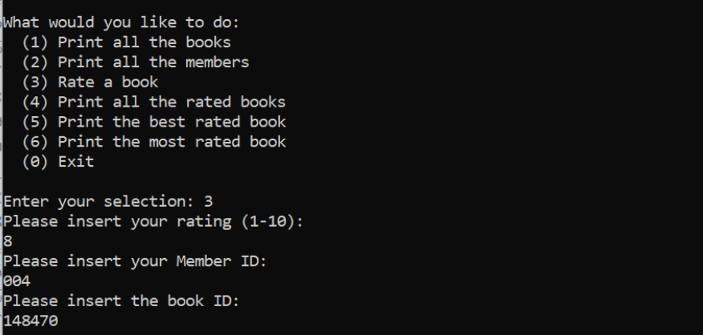
Execution of the Code - Option 3: Rate a book

Slide 76
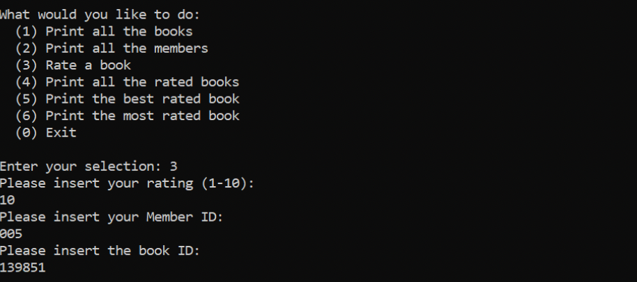
Execution of the Code - Option 3: Rate a book

Slide 77
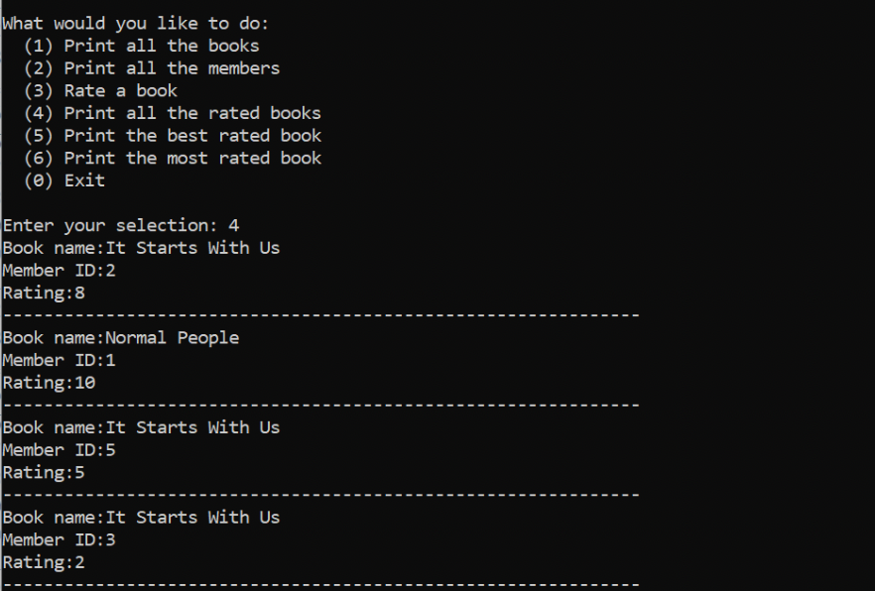
Execution of the Code - Option 4: Print all the rated books

Slide 78
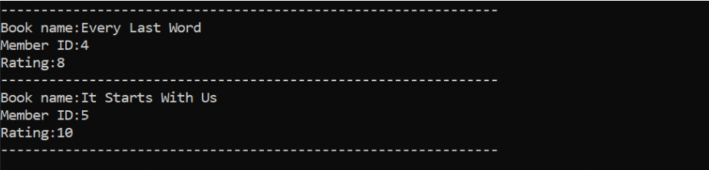
Execution of the Code - Option 4: Print all the rated books

Slide 79
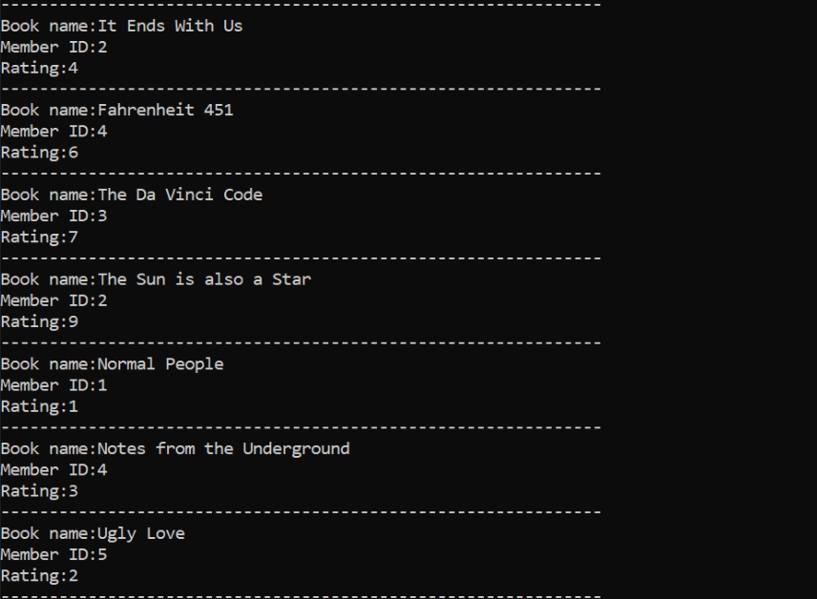
Execution of the Code - Option 4: Print all the rated books

Slide 80
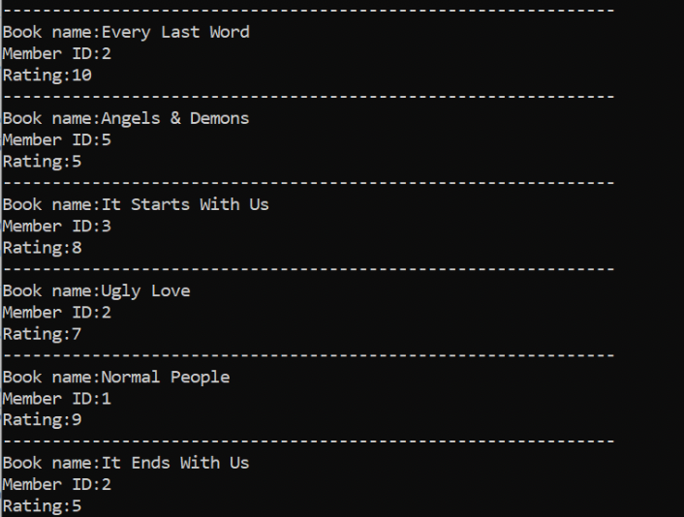
Execution of the Code - Option 4: Print all the rated books

Slide 81
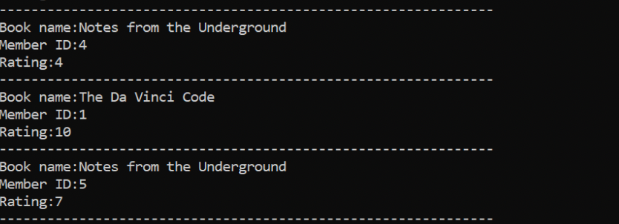
Execution of the Code - Option 4: Print all the rated books

Slide 82
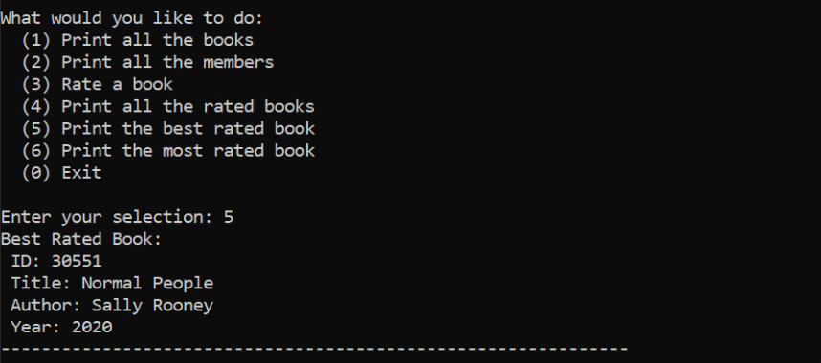
Execution of the Code - Option 5: Print the best rated book

Slide 83

Execution of the Code - Option 6: Print the most rated book

Slide 84

Execution of the Code - Option 0: Exit

Slide 85
/14
/TEAMWORK & PROJECT MANAGEMENT
Teamwork & Project Management

Slide 86
/Teamwork Management
Teamwork & Project Management
/Leen Sharab | /Ameera Attiah | /Sara Alshumayri | /Esraa Basalama
BkArray.cc/BkArray.h | CmArray.cc/CmArray.h | Book.cc/Book.h | ClubMember.cc
BookClub.cc/BookClub.h | BookClub.cc/BookClub.h | ClubMember.h | Control.cc/Control.h
Report | PPT Presentation | View.cc/View.h | Rating.h/Rating.cc
Comments | Makefile | Report | Report
 | Comments

Slide 87
<15>
<CONCLUSION & REFLECTION>
Conclusion & Reflection
This project was a significant challenge for all of us. While creating the code, we faced various problems and errors. It is not a simple code, but thanks to our incredible teamwork, we were able to complete it all while aiming for the greatest grades. We are grateful to our colleagues, sophomores, and family members for their assistance in guiding us. This project has improved our coding skills and we have learned a lot from it.

Slide 88

/Thank You For Listening
Thank You

Slide 89
/PROGRAMMING ICON PACK

Slide 90
/ALTERNATIVE RESOURCES

